Slide 1
Programming Fundamental: Databases
By AltoTech

Slide 2
1.Understanding Databases

Slide 3
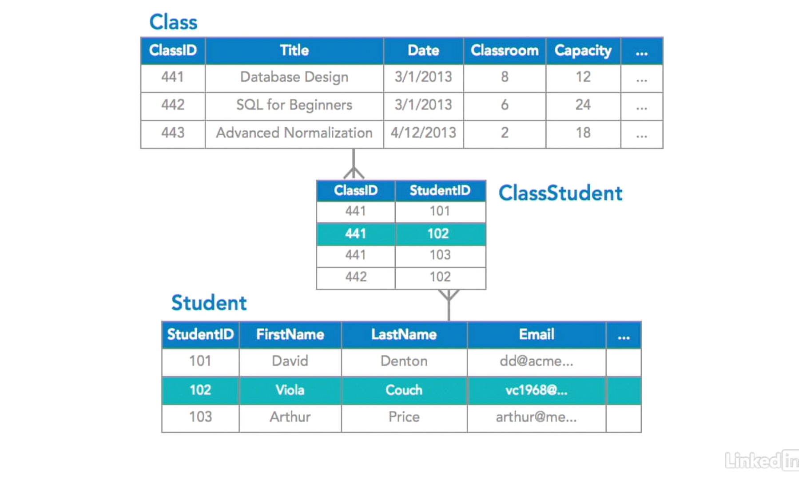
What are databases?

Slide 4
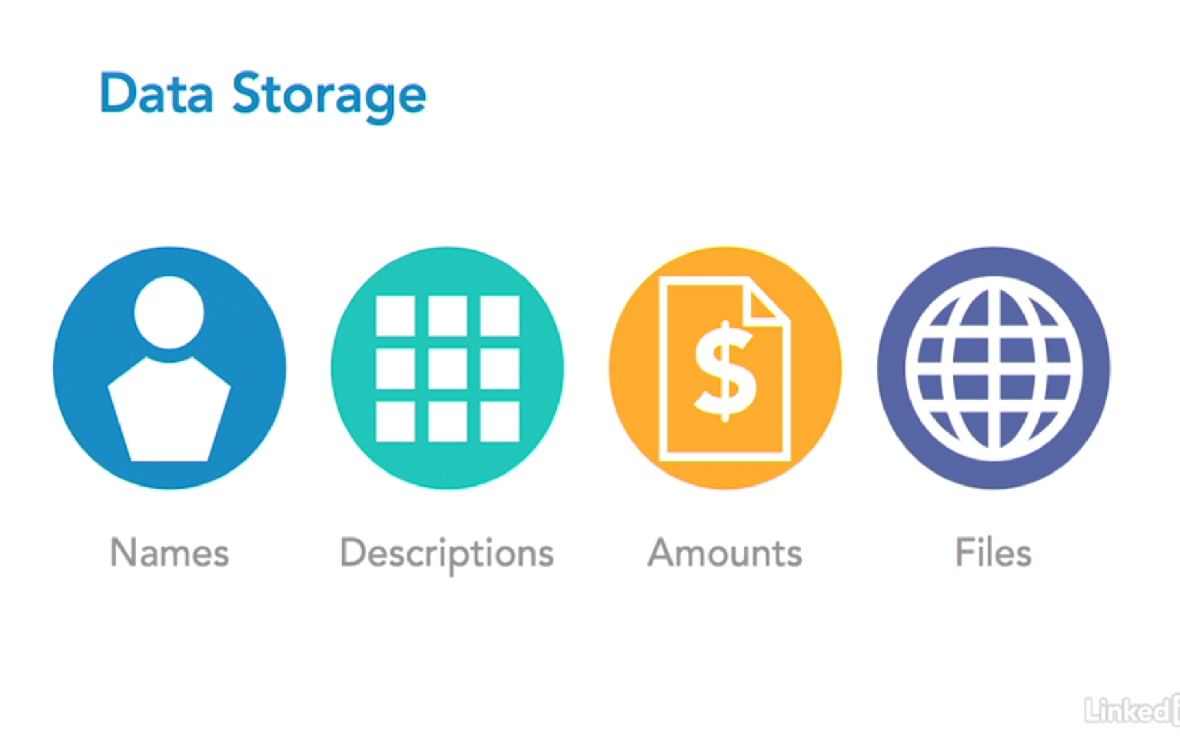
What are databases?

Slide 5
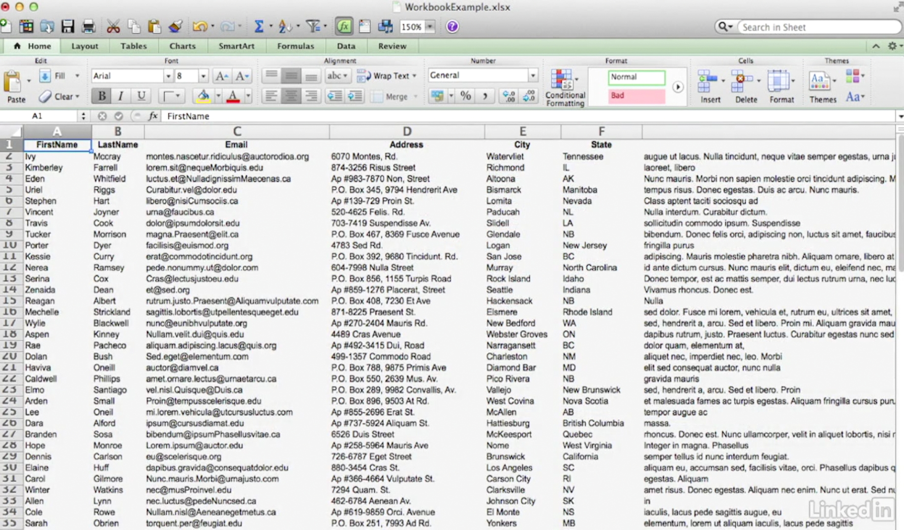
What are databases?

Slide 6
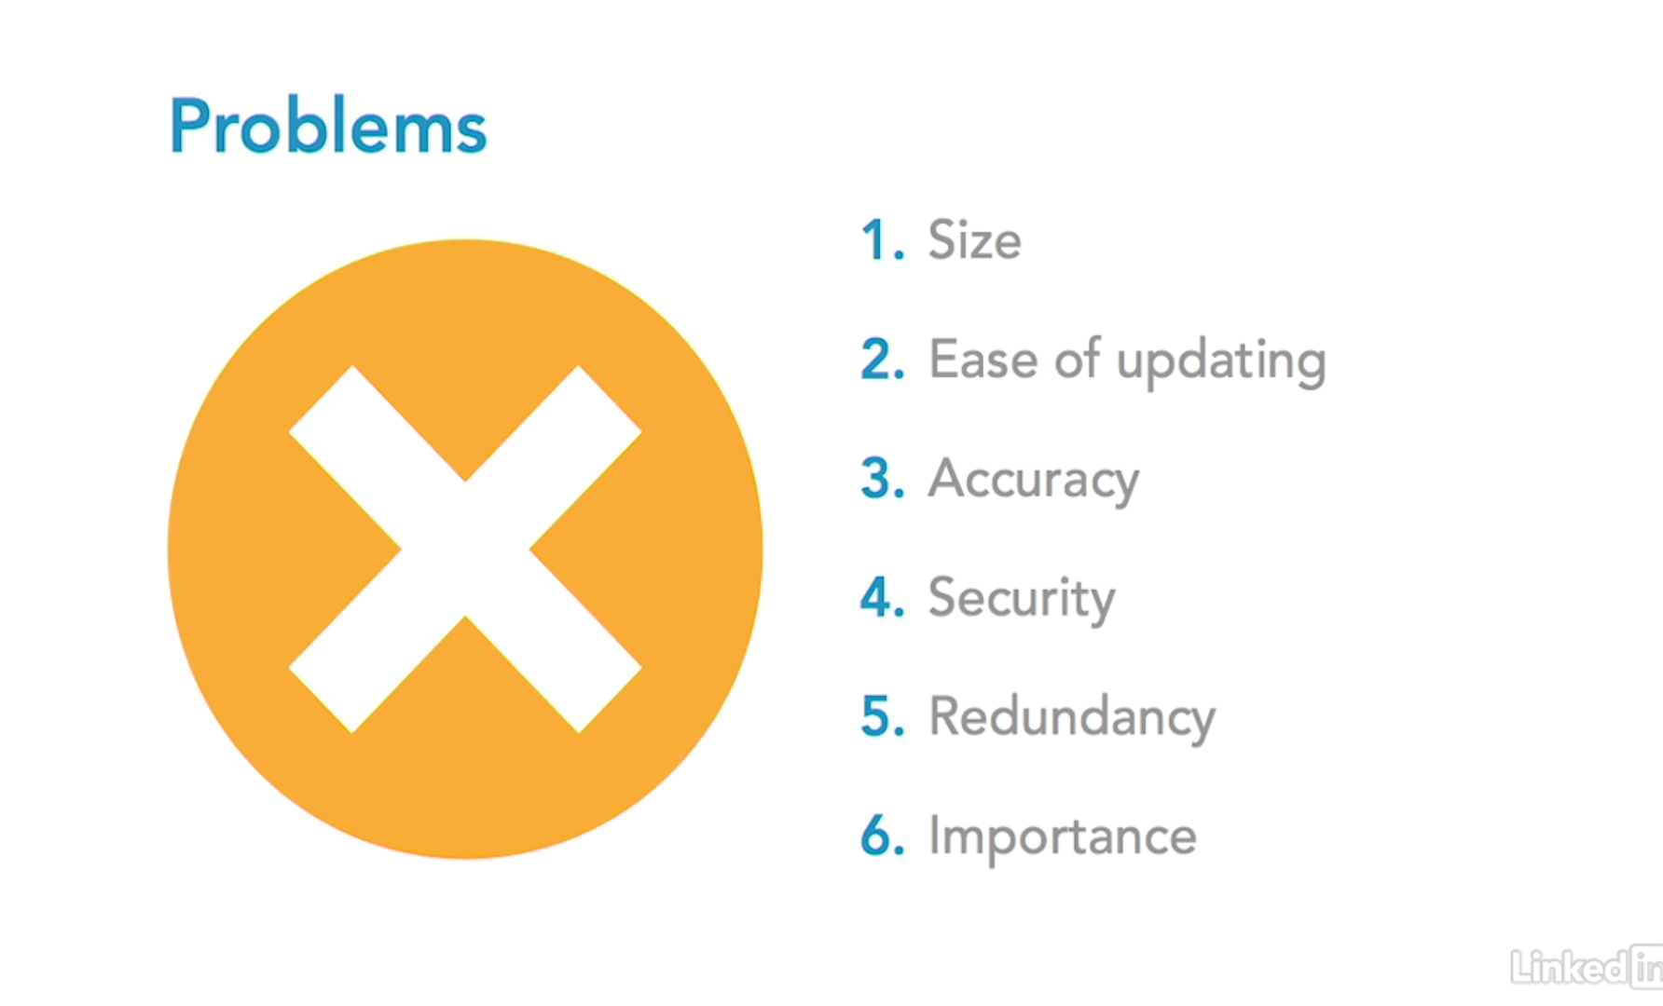
What are databases?

Slide 7
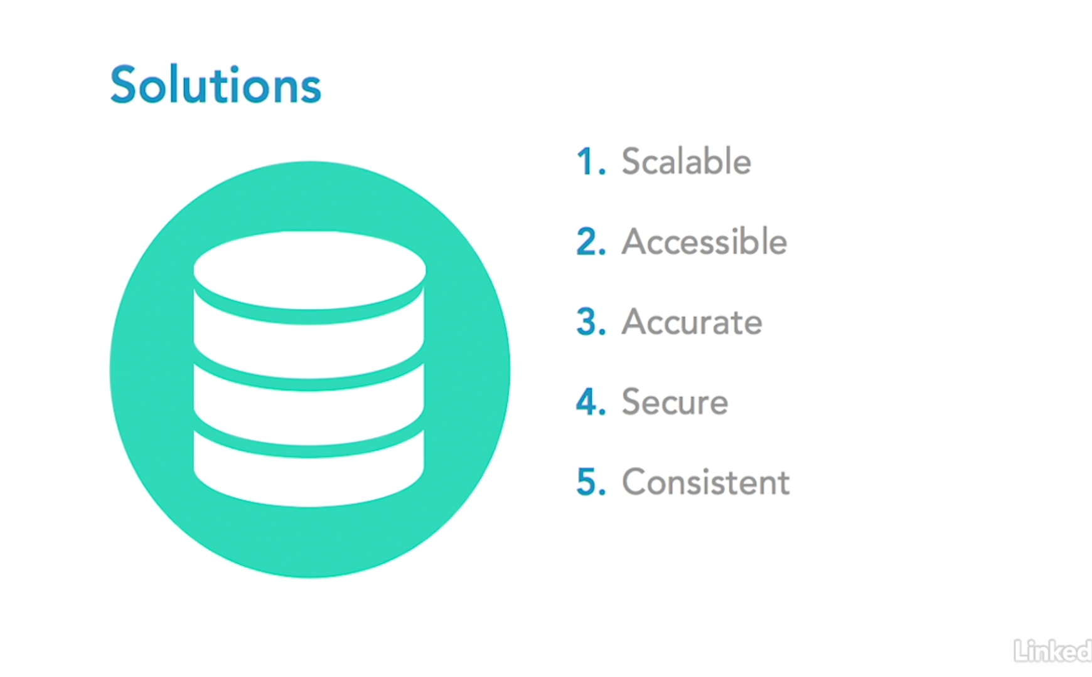
What are databases?

Slide 8
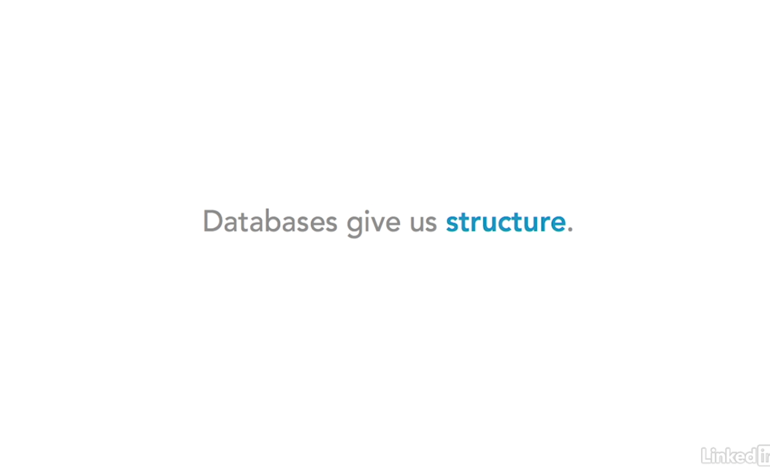
What are databases?

Slide 9
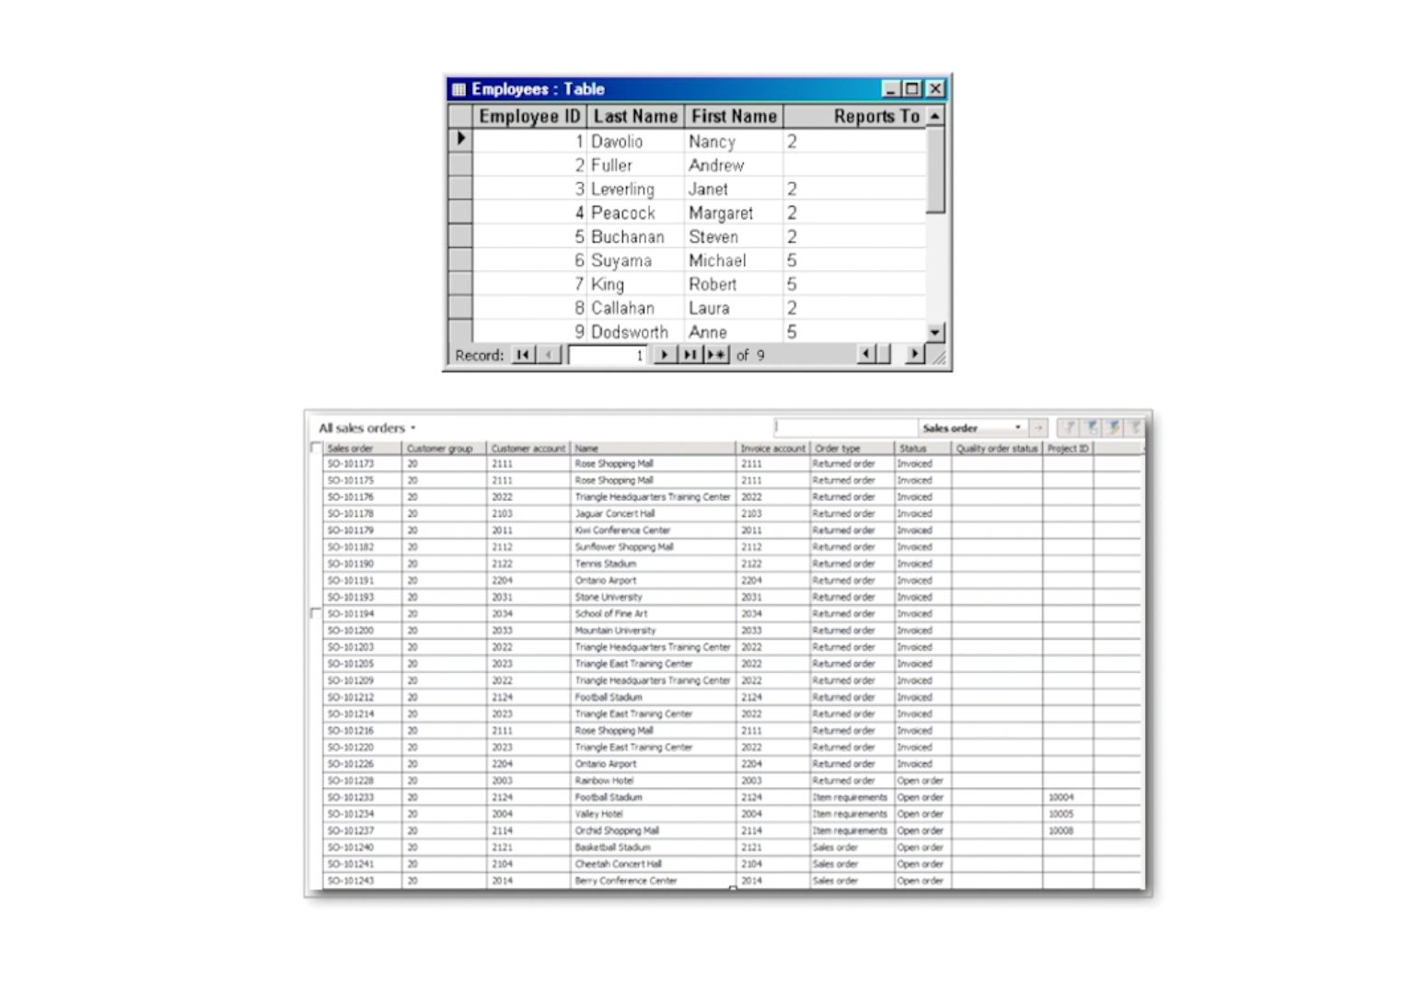
What are databases?

Slide 10
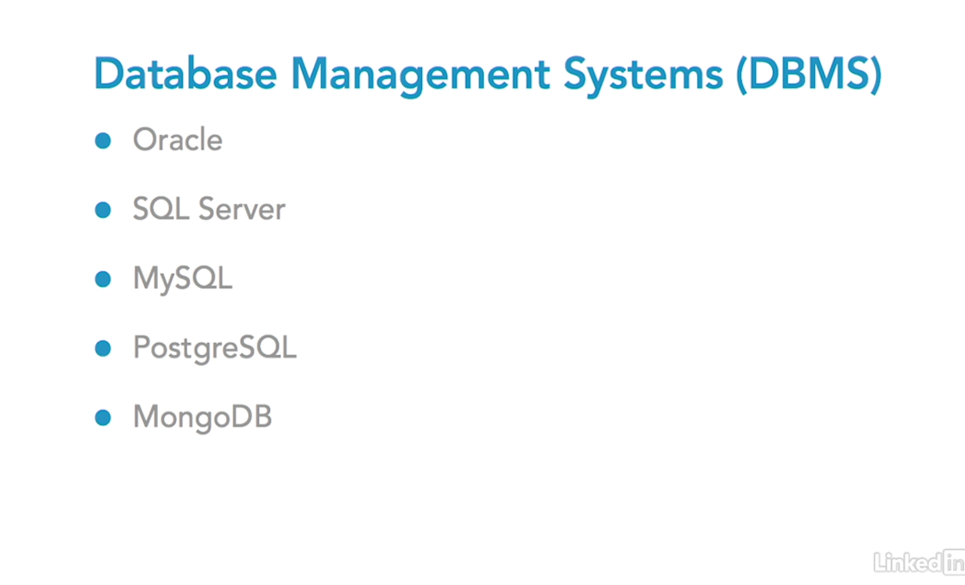
Exploring Database Management Systems

Slide 11
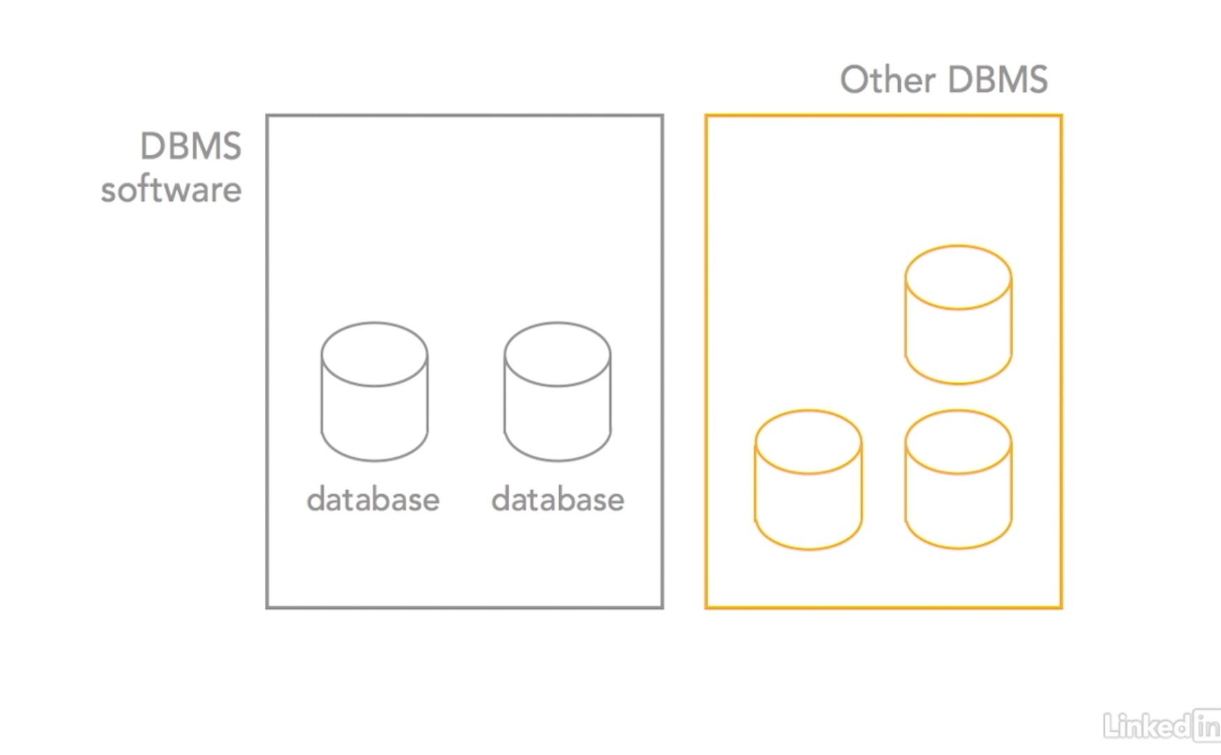
Exploring Database Management Systems

Slide 12
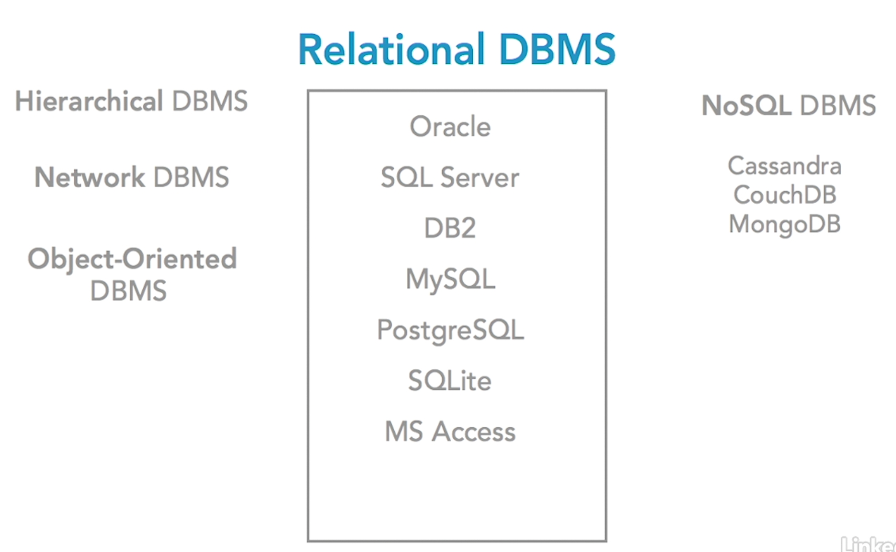
Exploring Database Management Systems

Slide 13
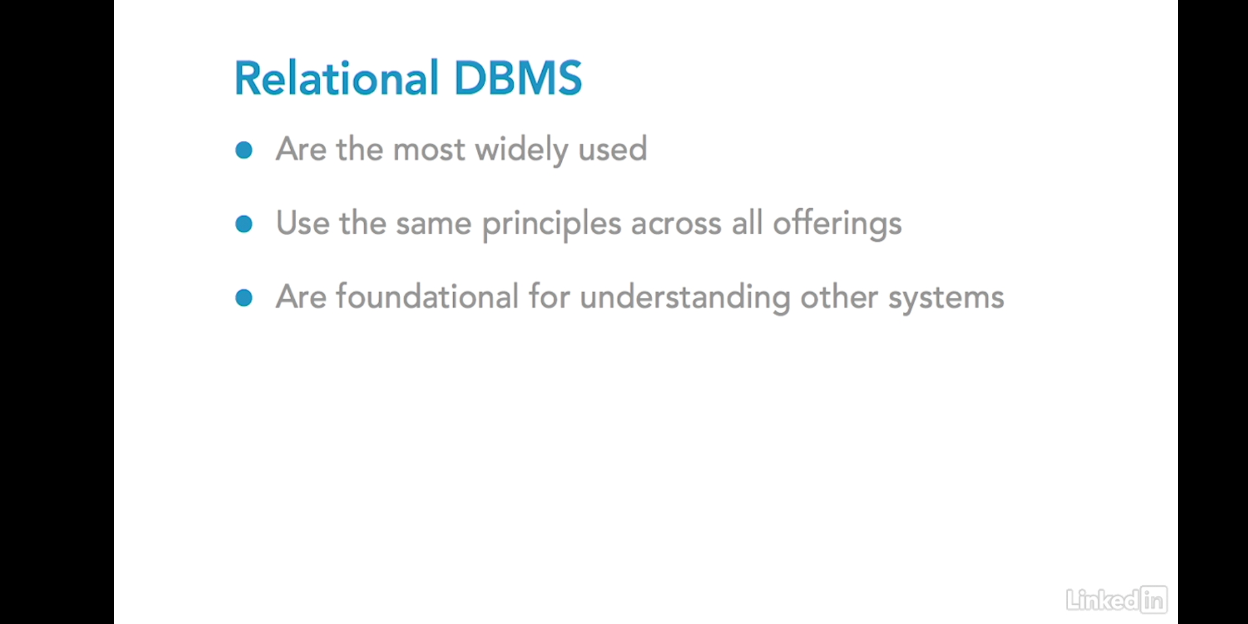
Exploring Database Management Systems

Slide 14
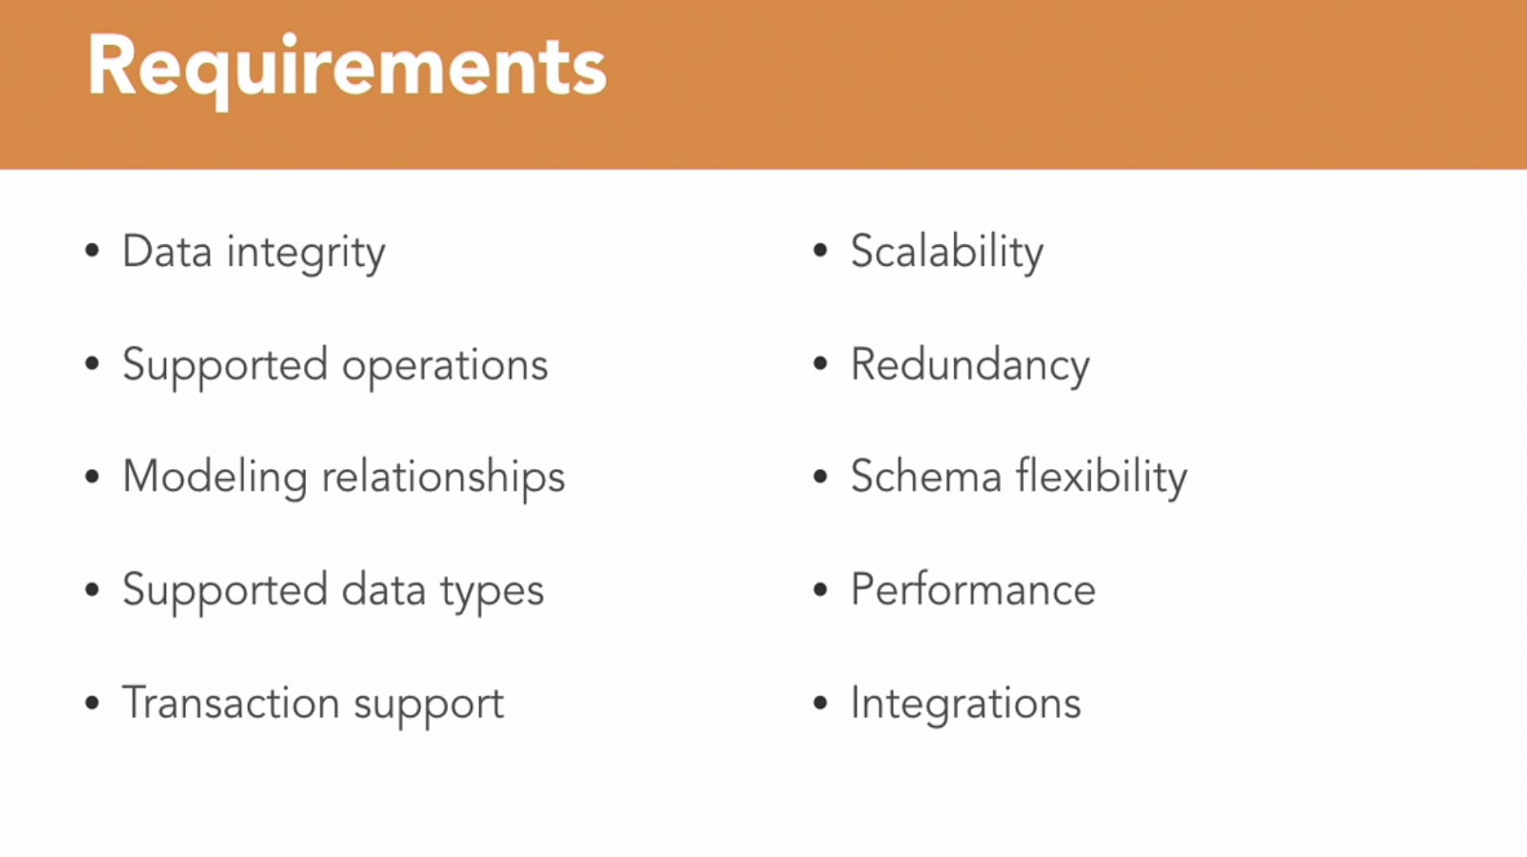
Choosing Database for Your Projects

Slide 15
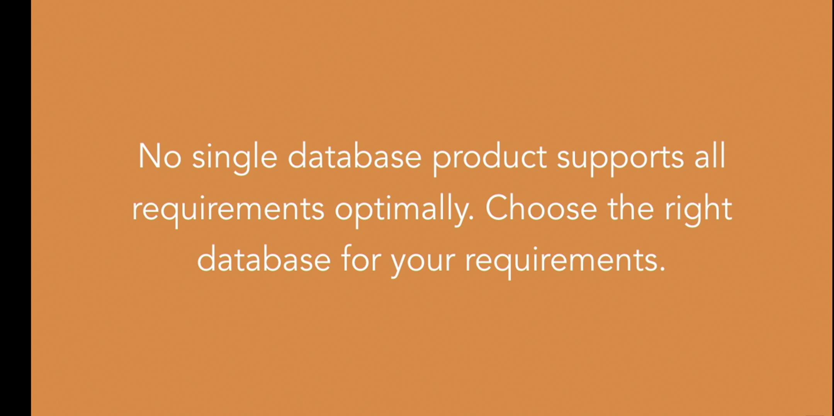
Choosing Database for Your Projects

Slide 16
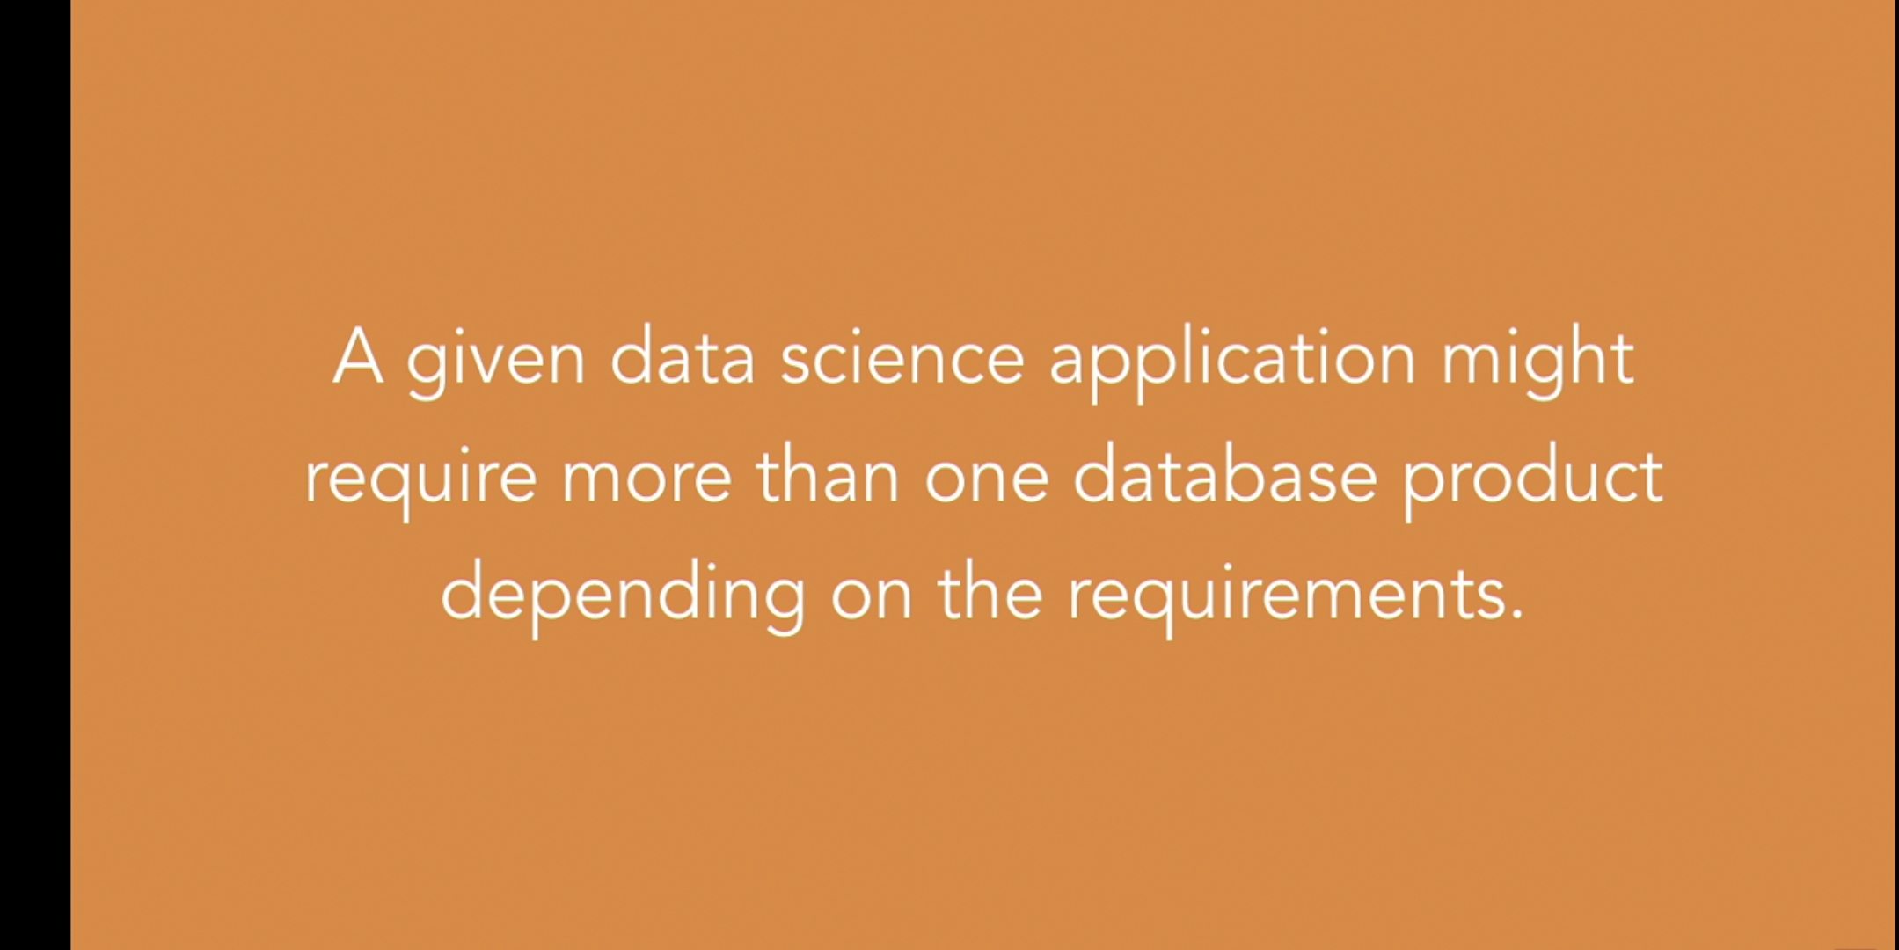
Choosing Database for Your Projects

Slide 17
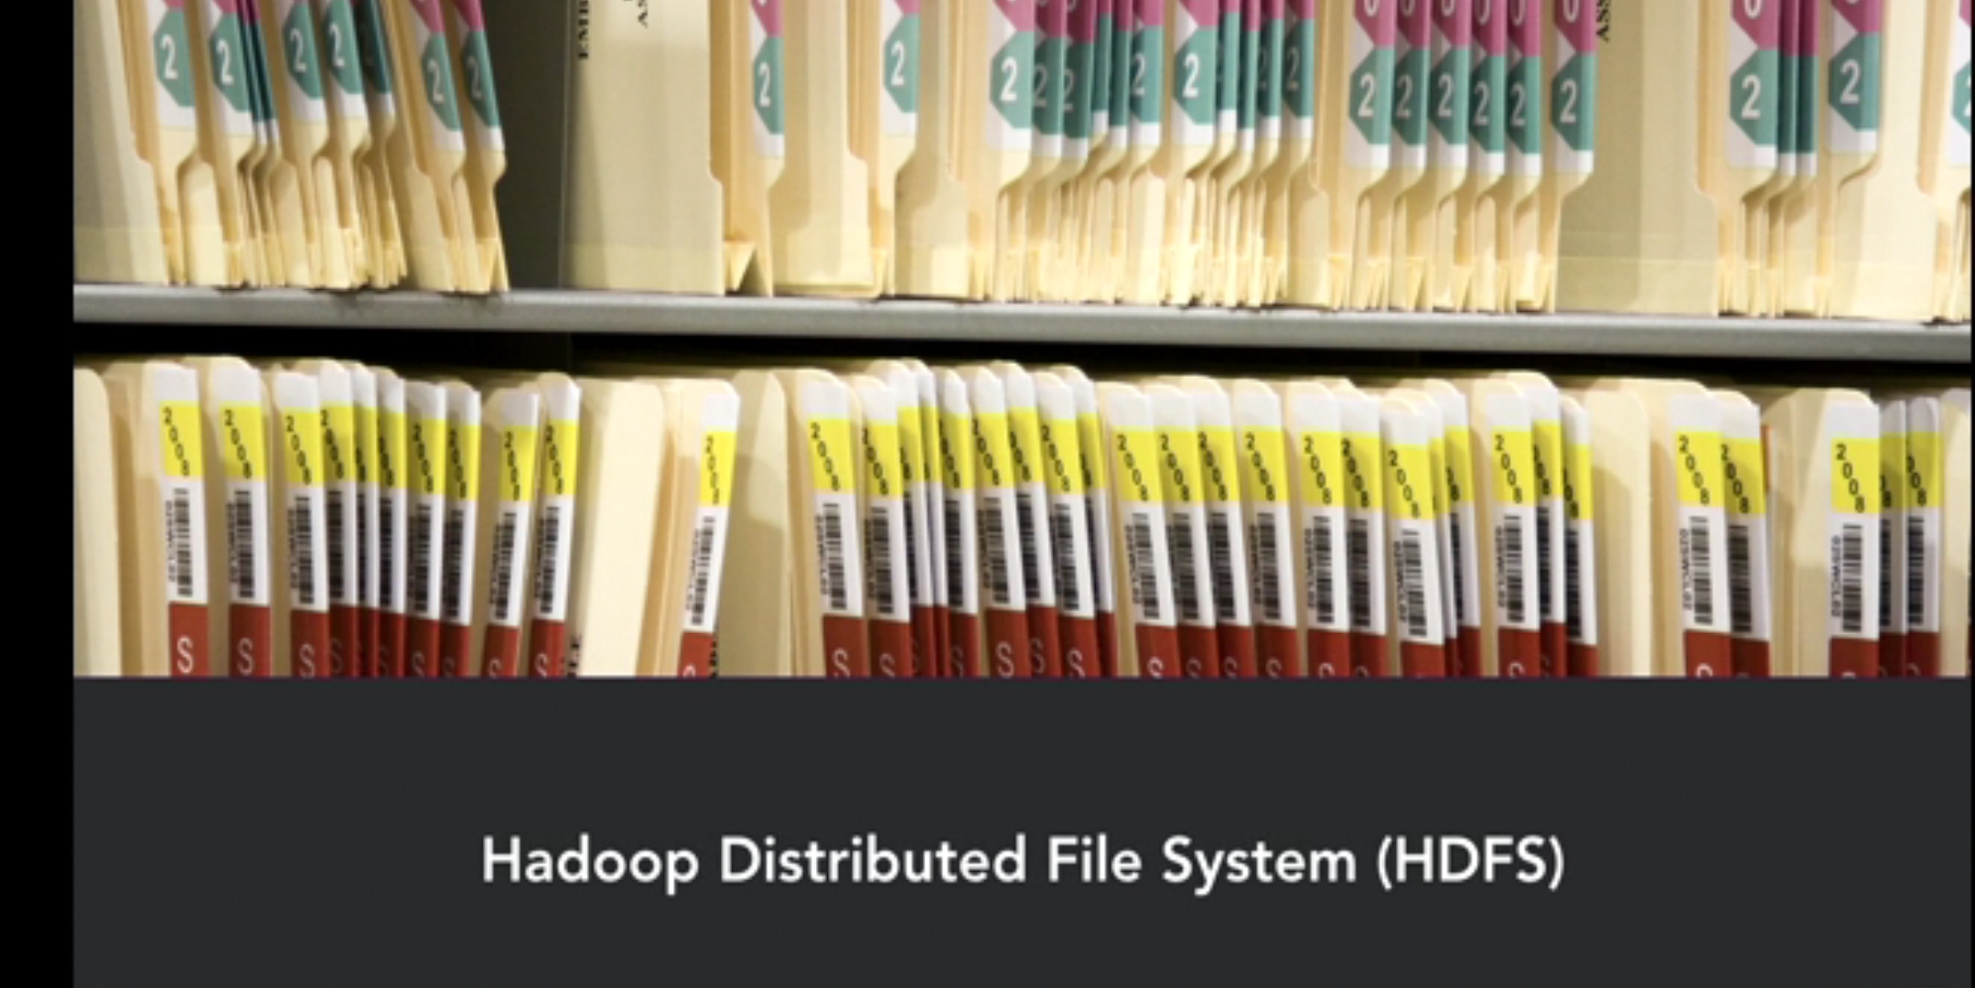
Choosing Database for Your Projects

Slide 18
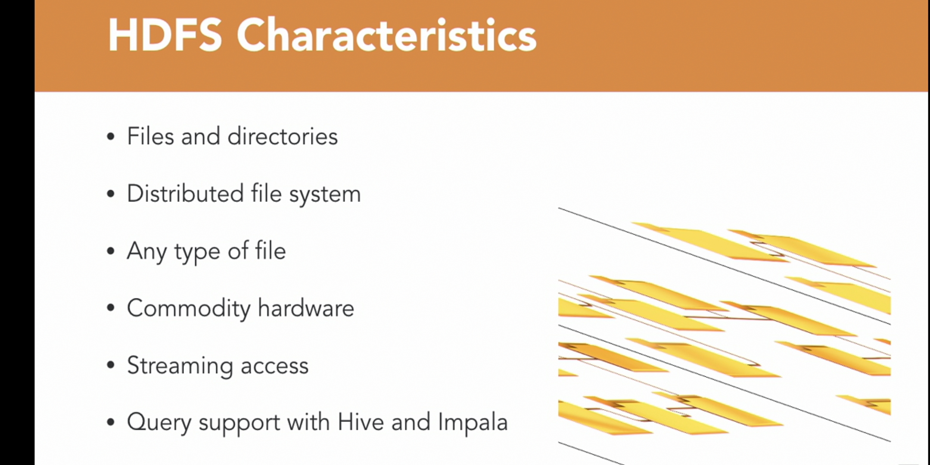
Choosing Database for Your Projects

Slide 19
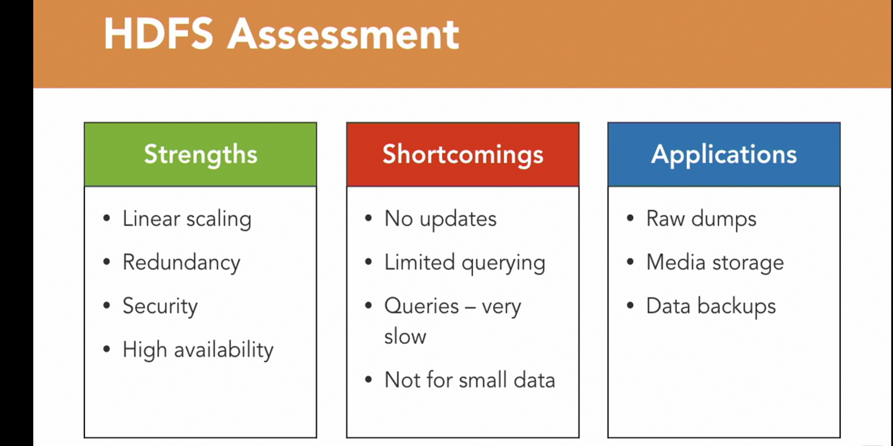
Choosing Database for Your Projects

Slide 20

Choosing Database for Your Projects

Slide 21
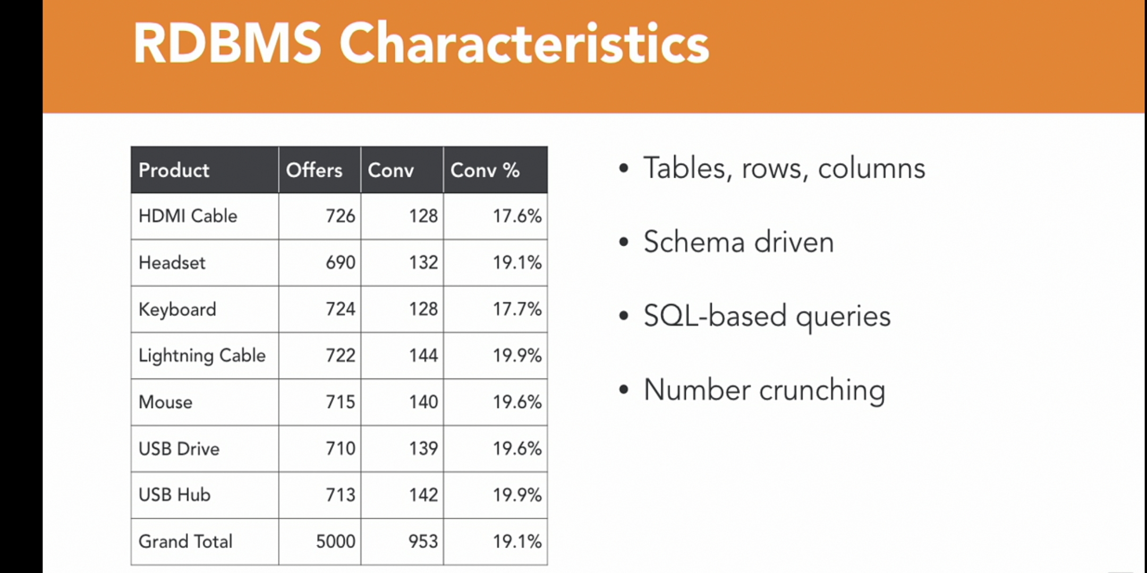
Choosing Database for Your Projects

Slide 22
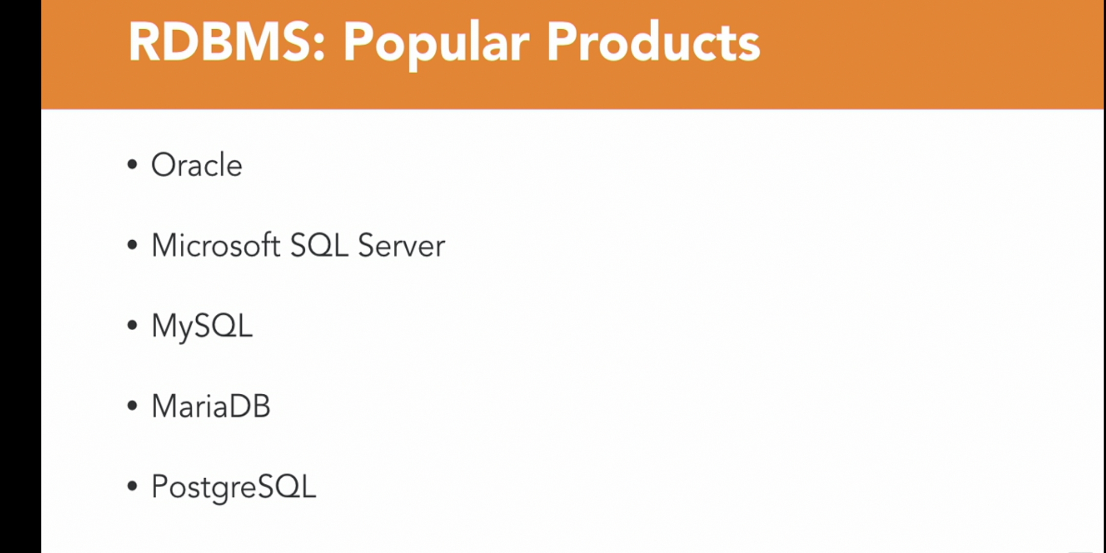
Choosing Database for Your Projects

Slide 23
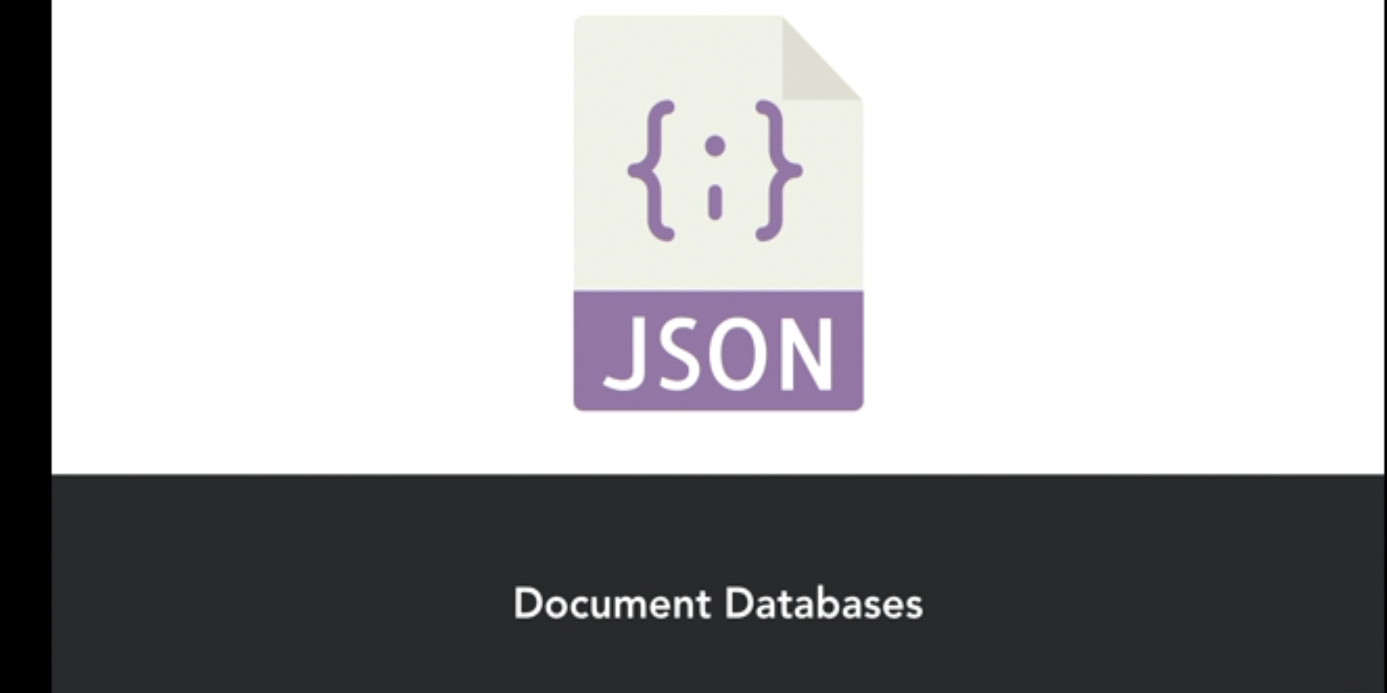
Choosing Database for Your Projects

Slide 24
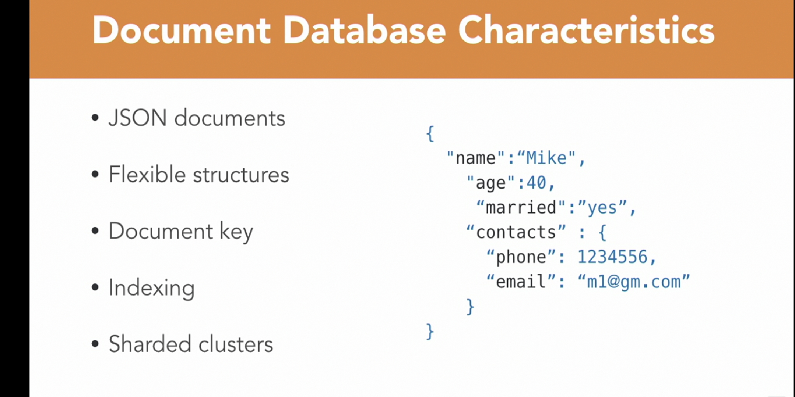
Choosing Database for Your Projects

Slide 25
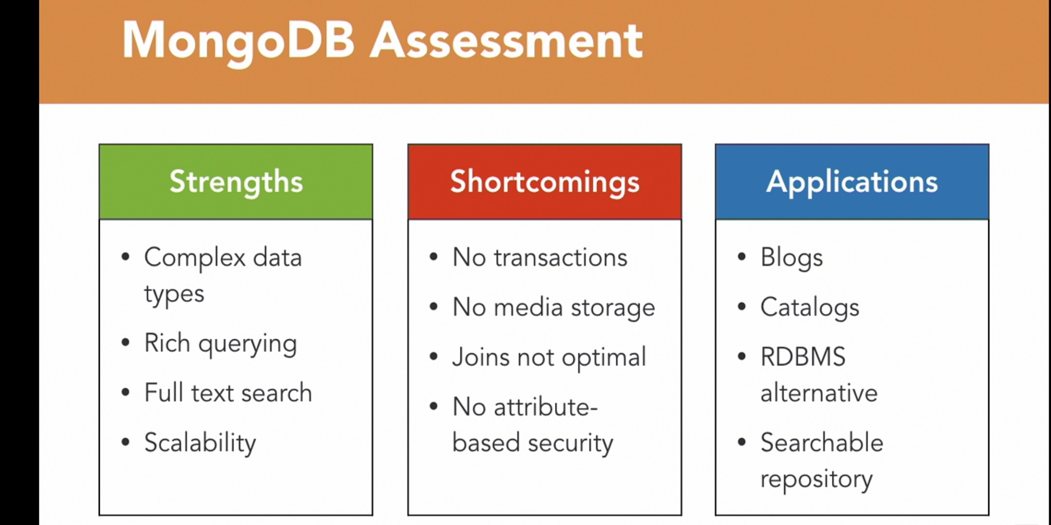
Choosing Database for Your Projects

Slide 26

Choosing Database for Your Projects

Slide 27
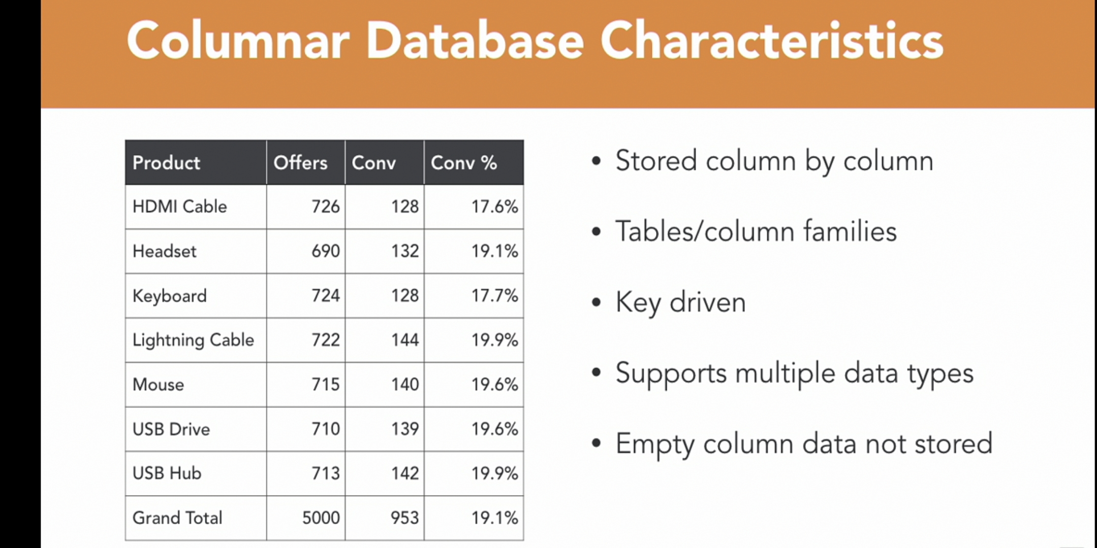
Choosing Database for Your Projects

Slide 28
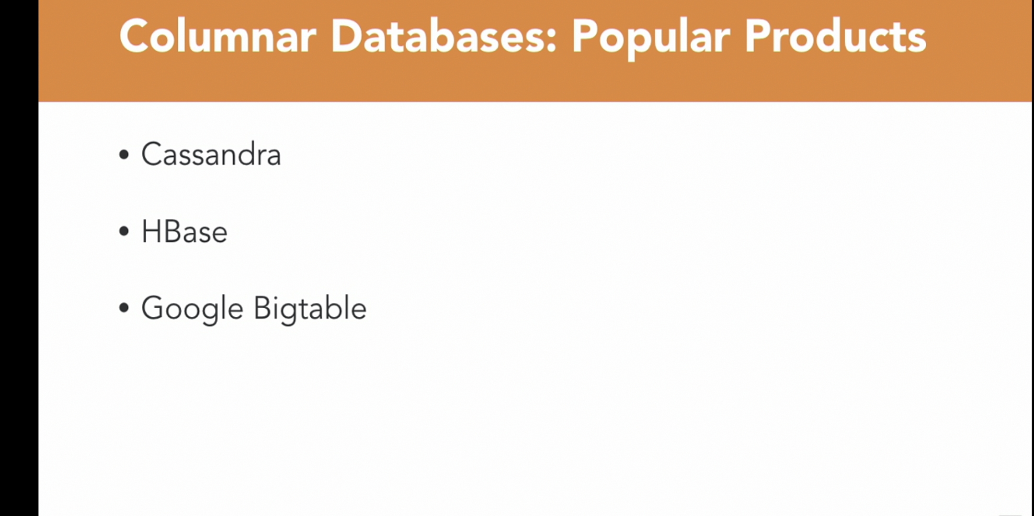
Choosing Database for Your Projects

Slide 29
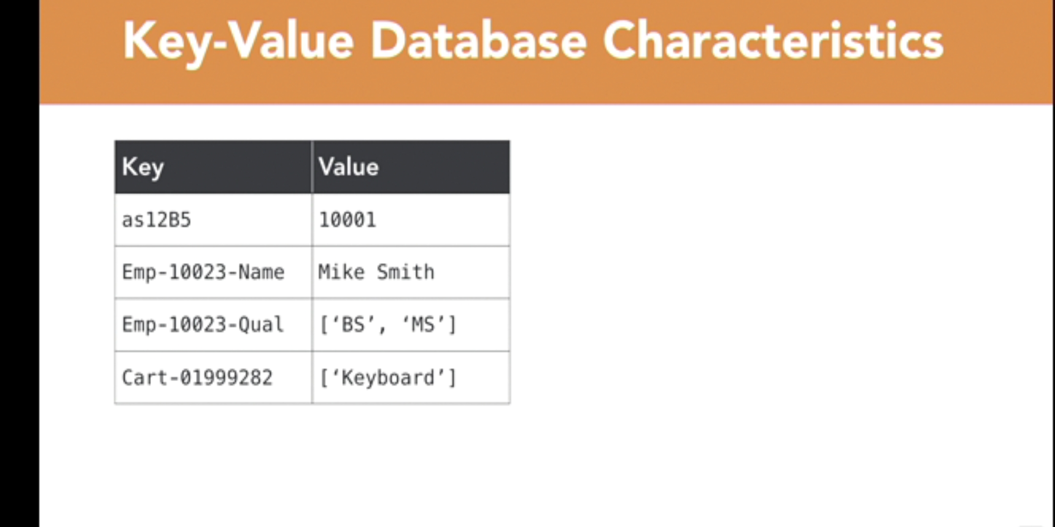
Choosing Database for Your Projects

Slide 30
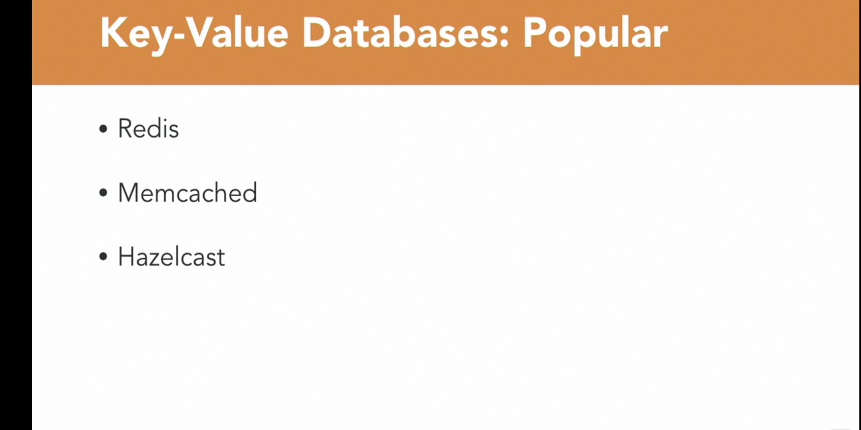
Choosing Database for Your Projects

Slide 31
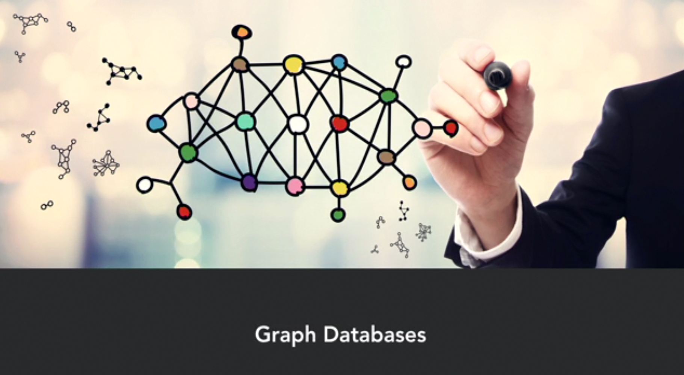
Choosing Database for Your Projects

Slide 32
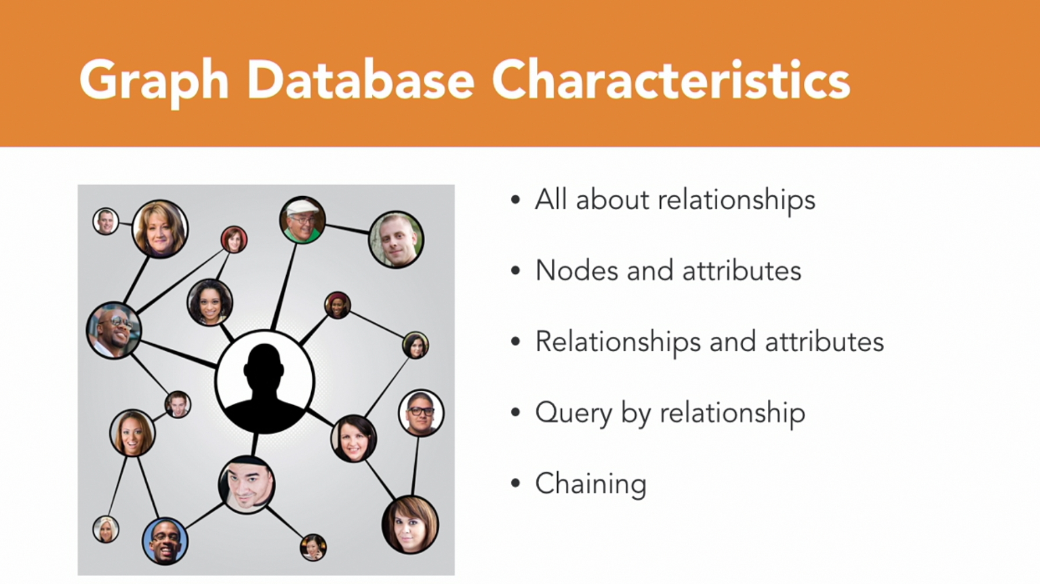
Choosing Database for Your Projects

Slide 33
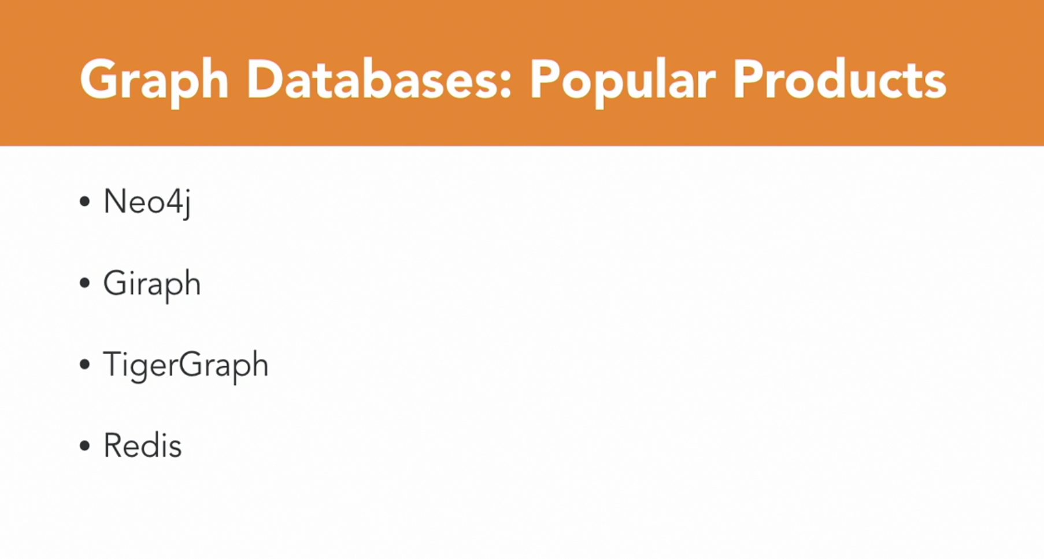
Choosing Database for Your Projects

Slide 34

Choosing Database for Your Projects

Slide 35
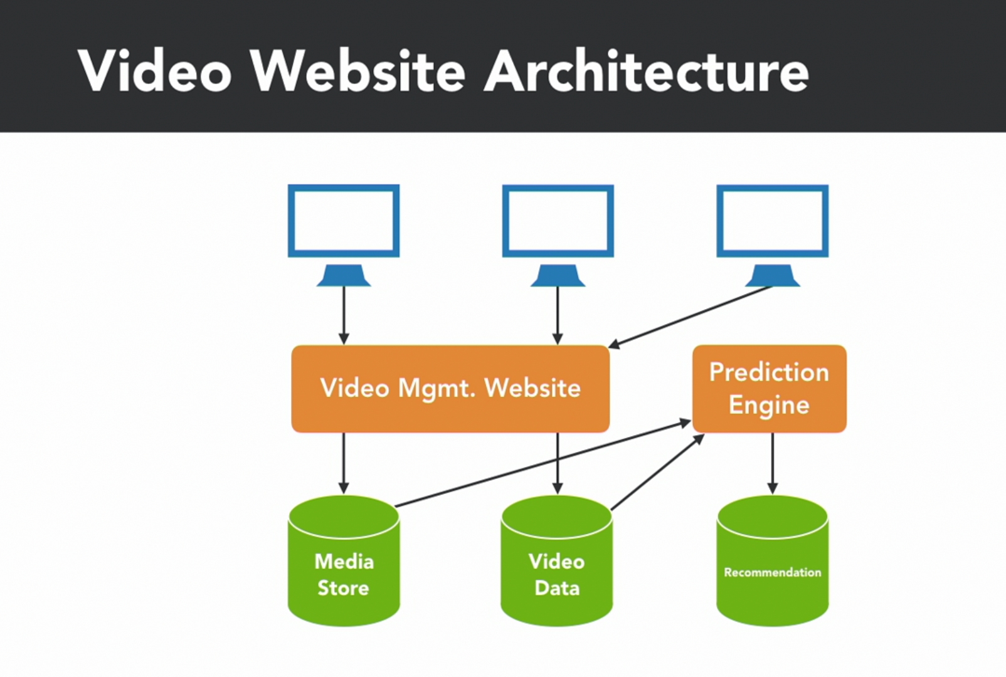
Choosing Database for Your Projects

Slide 36
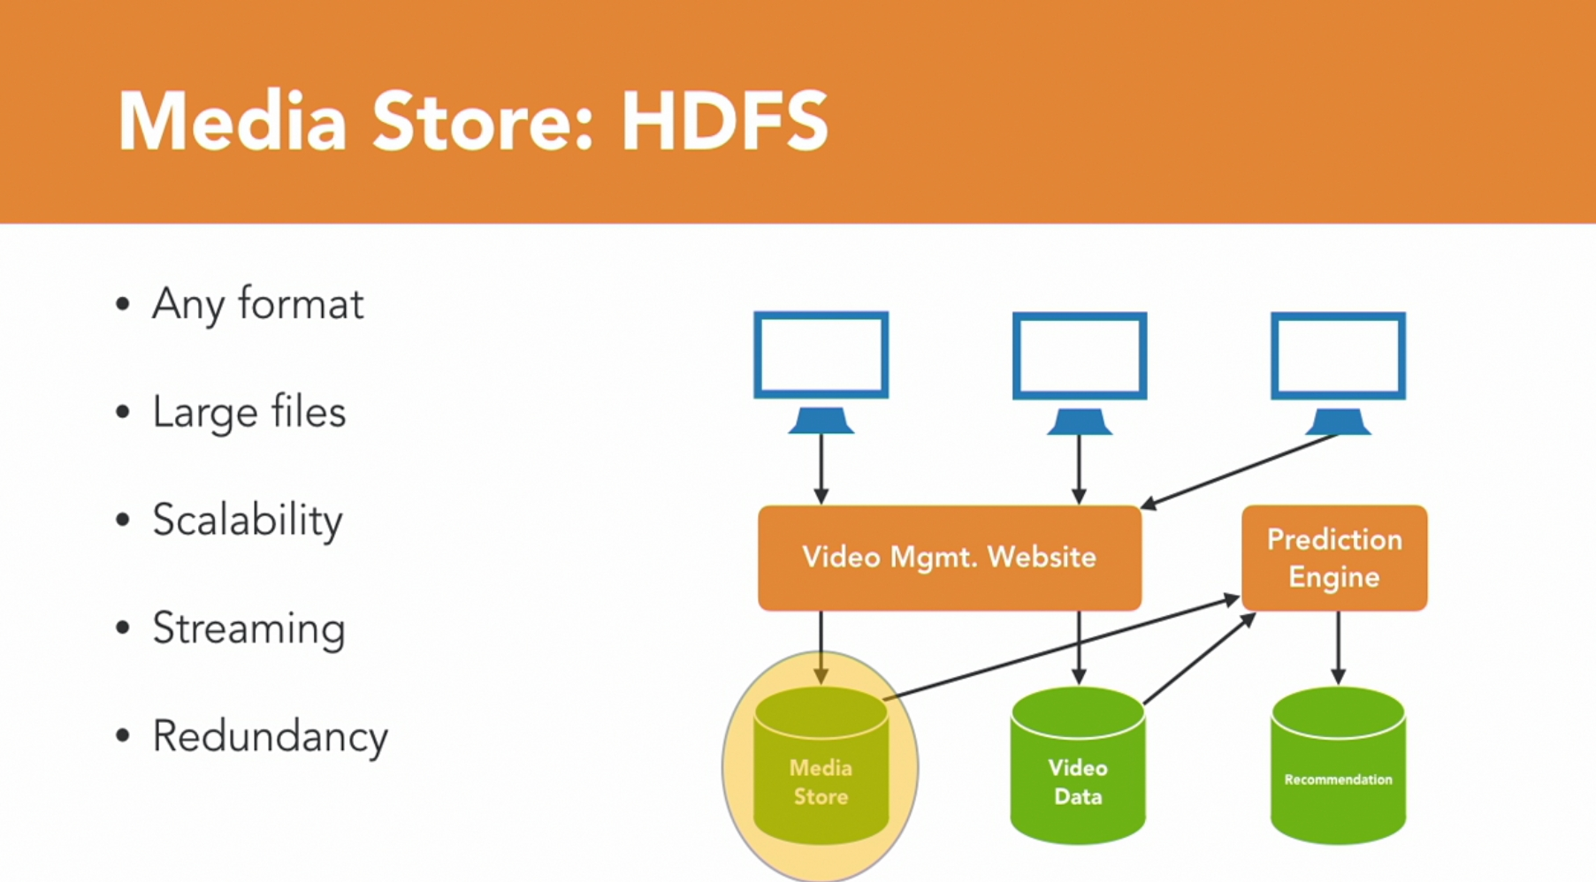
Choosing Database for Your Projects

Slide 37
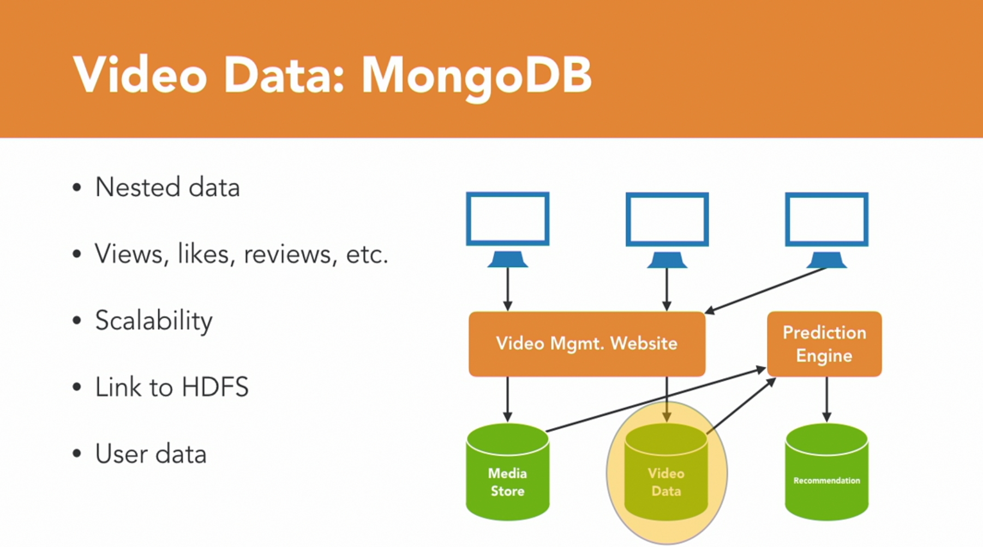
Choosing Database for Your Projects

Slide 38
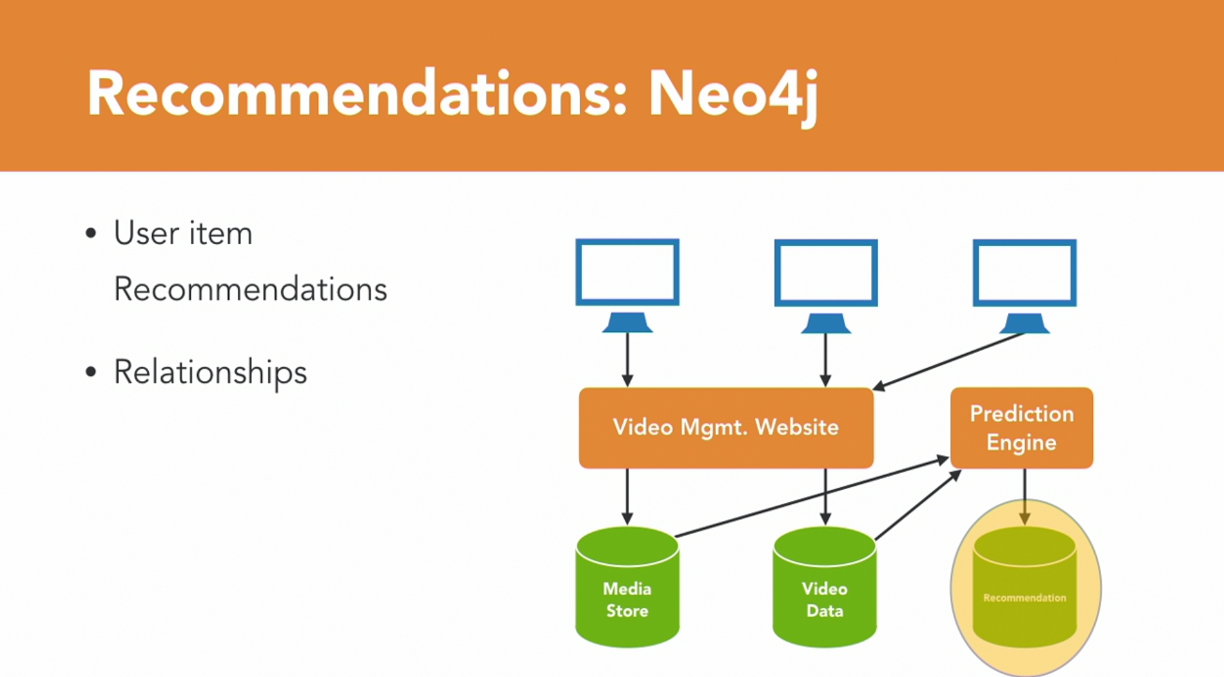
Choosing Database for Your Projects

Slide 39

Choosing Database for Your Projects

Slide 40
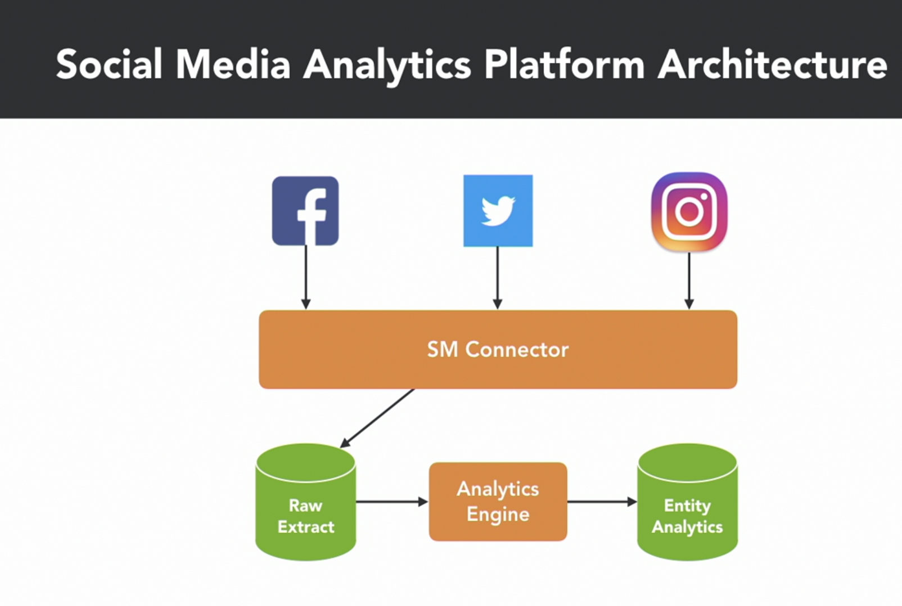
Choosing Database for Your Projects

Slide 41
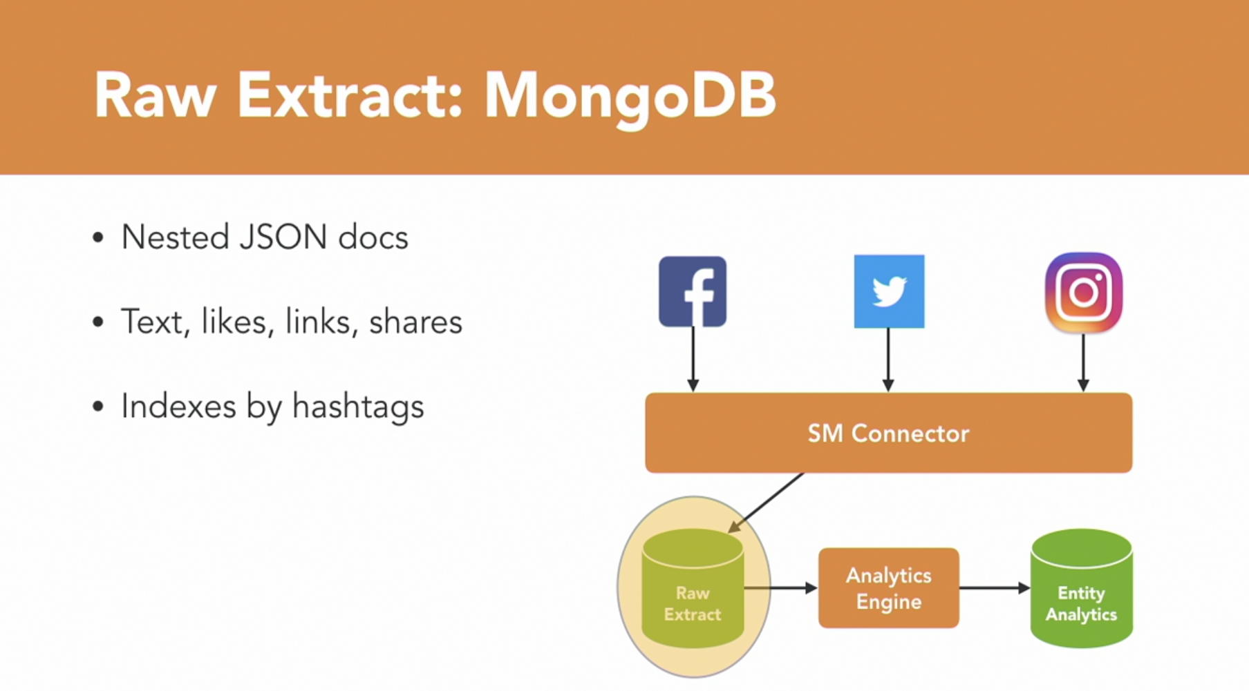
Choosing Database for Your Projects

Slide 42
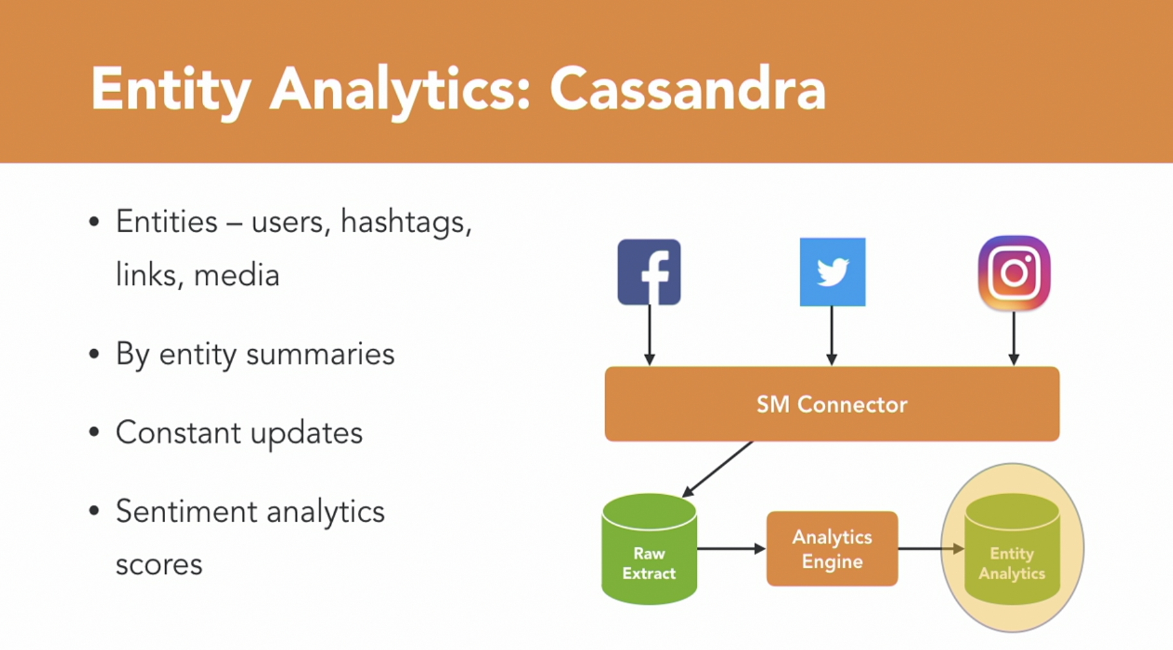
Choosing Database for Your Projects

Slide 43

Choosing Database for Your Projects

Slide 44
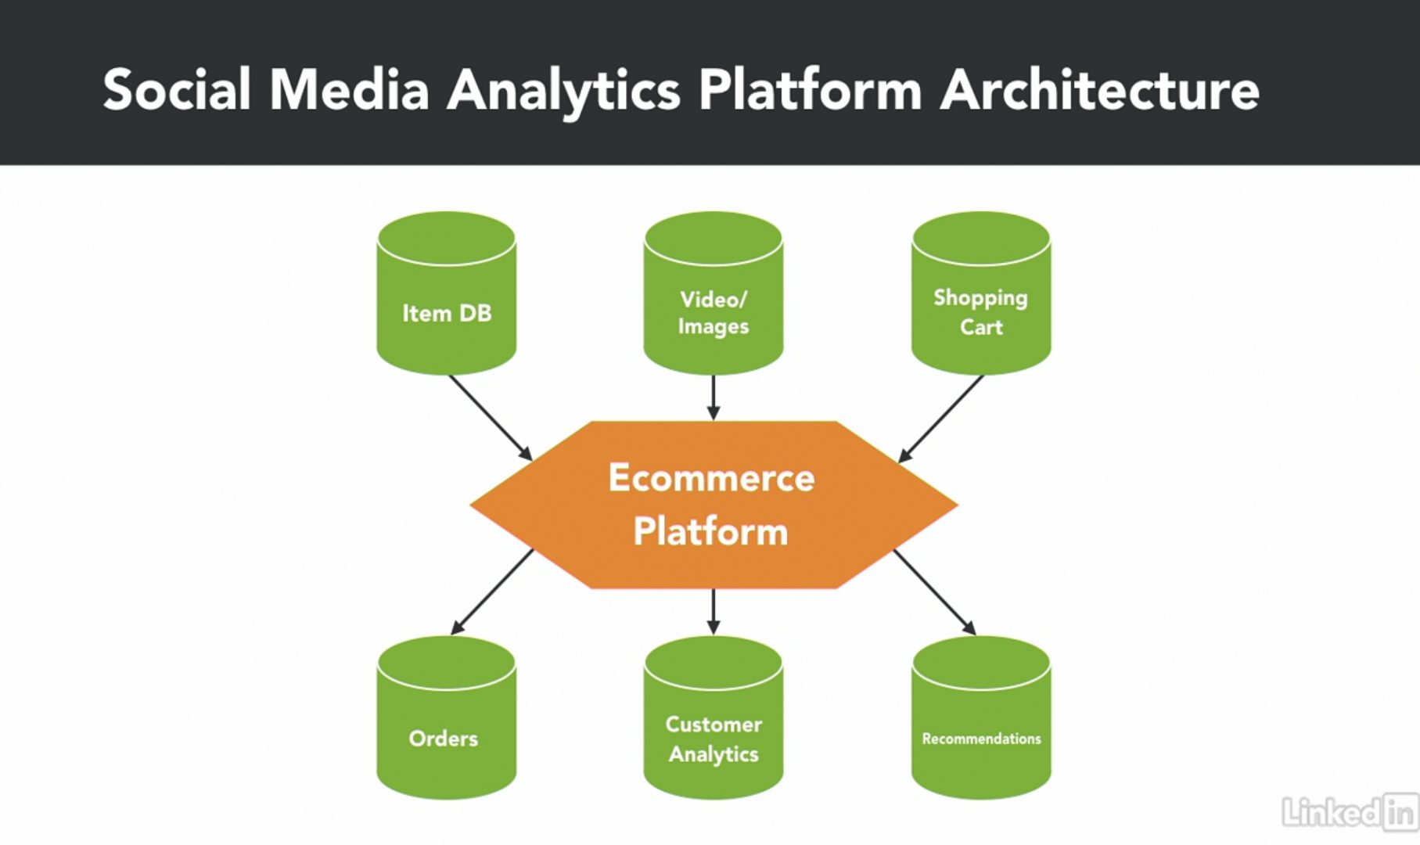
Choosing Database for Your Projects

Slide 45
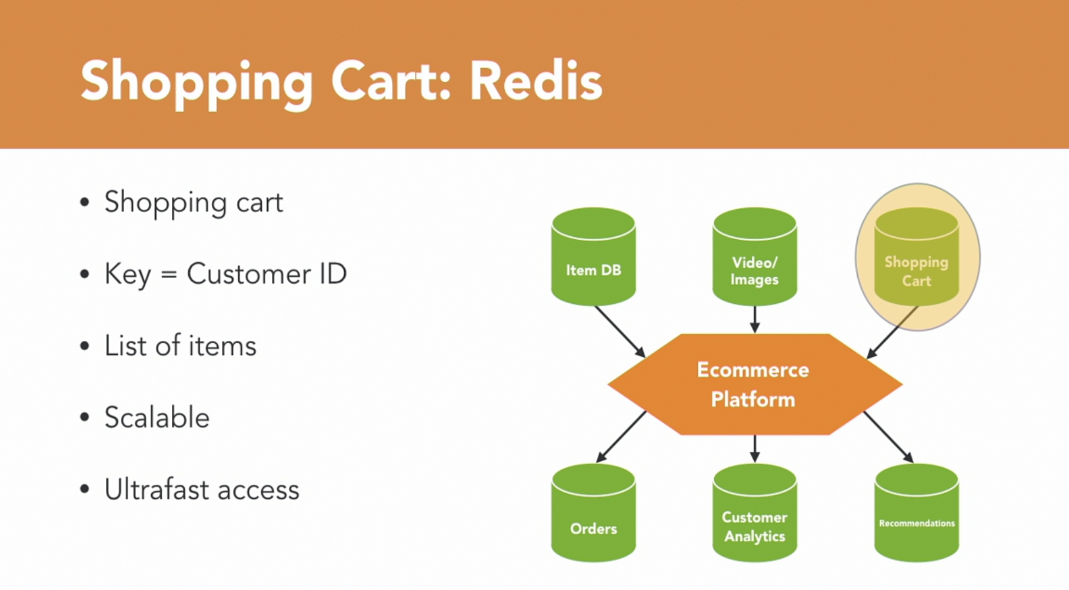
Choosing Database for Your Projects

Slide 46
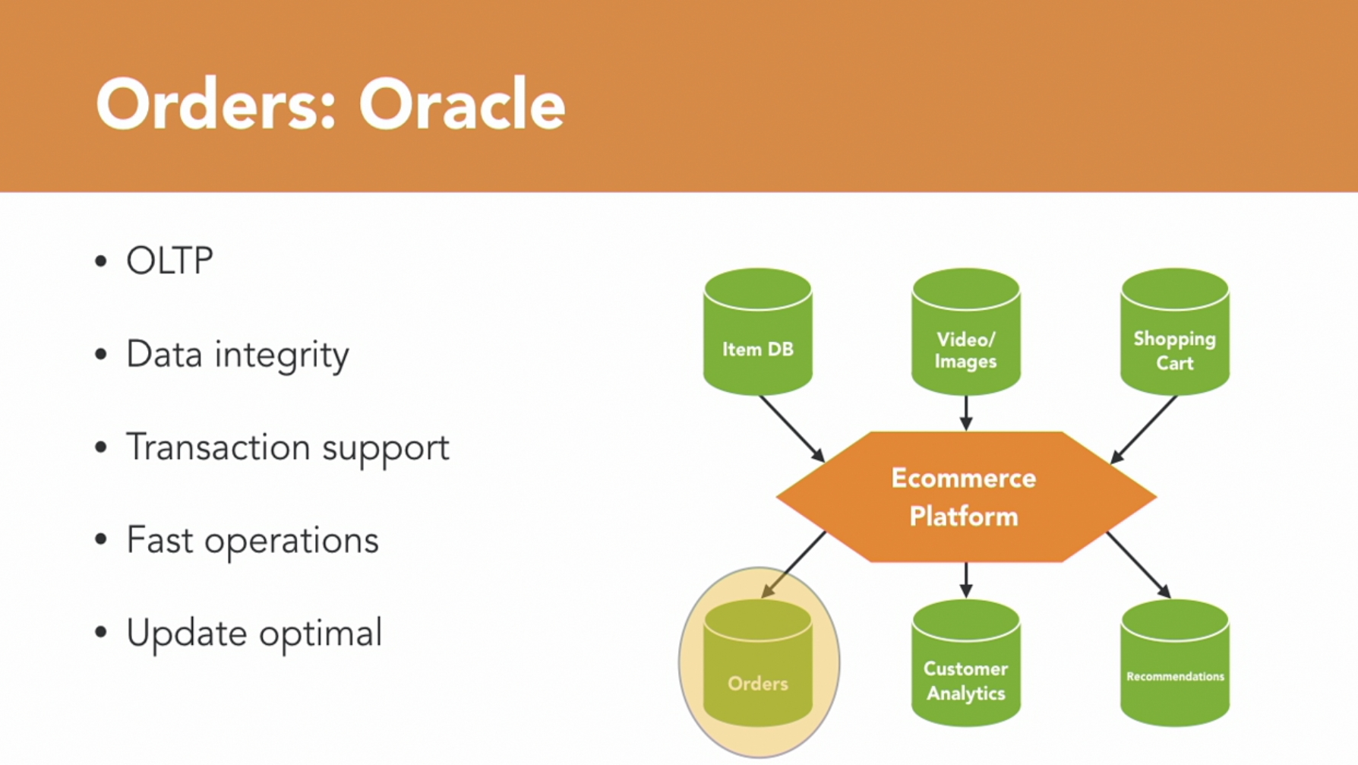
Choosing Database for Your Projects

Slide 47
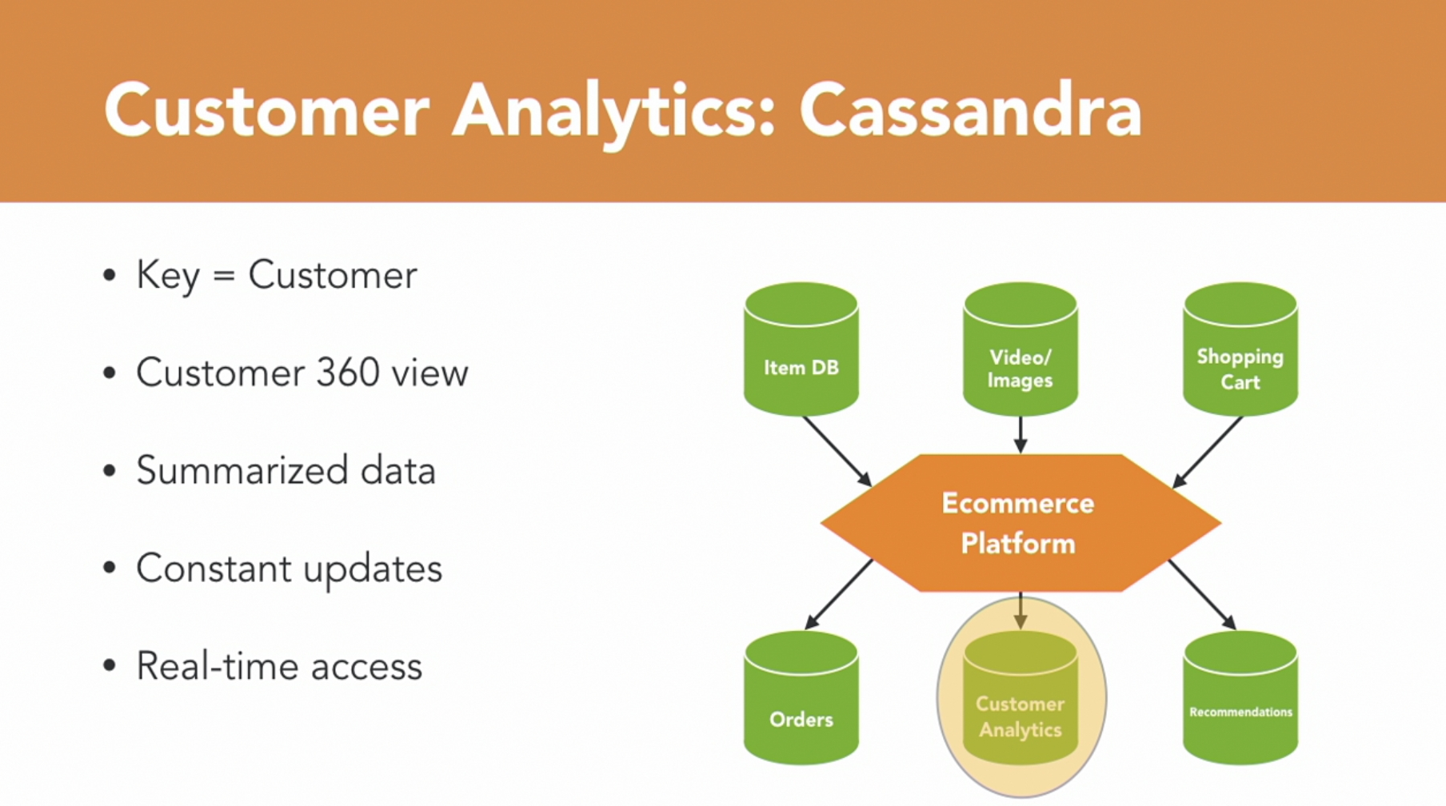
Choosing Database for Your Projects

Slide 48
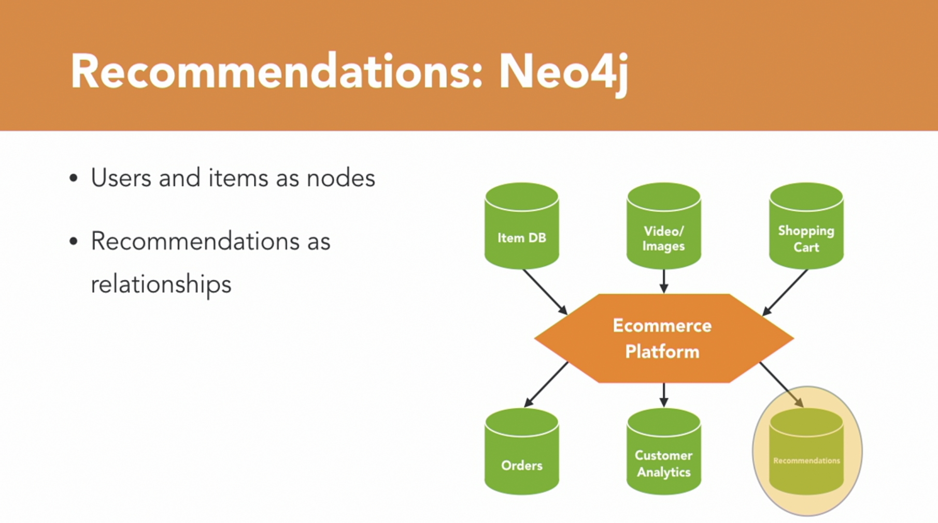
Choosing Database for Your Projects

Slide 49
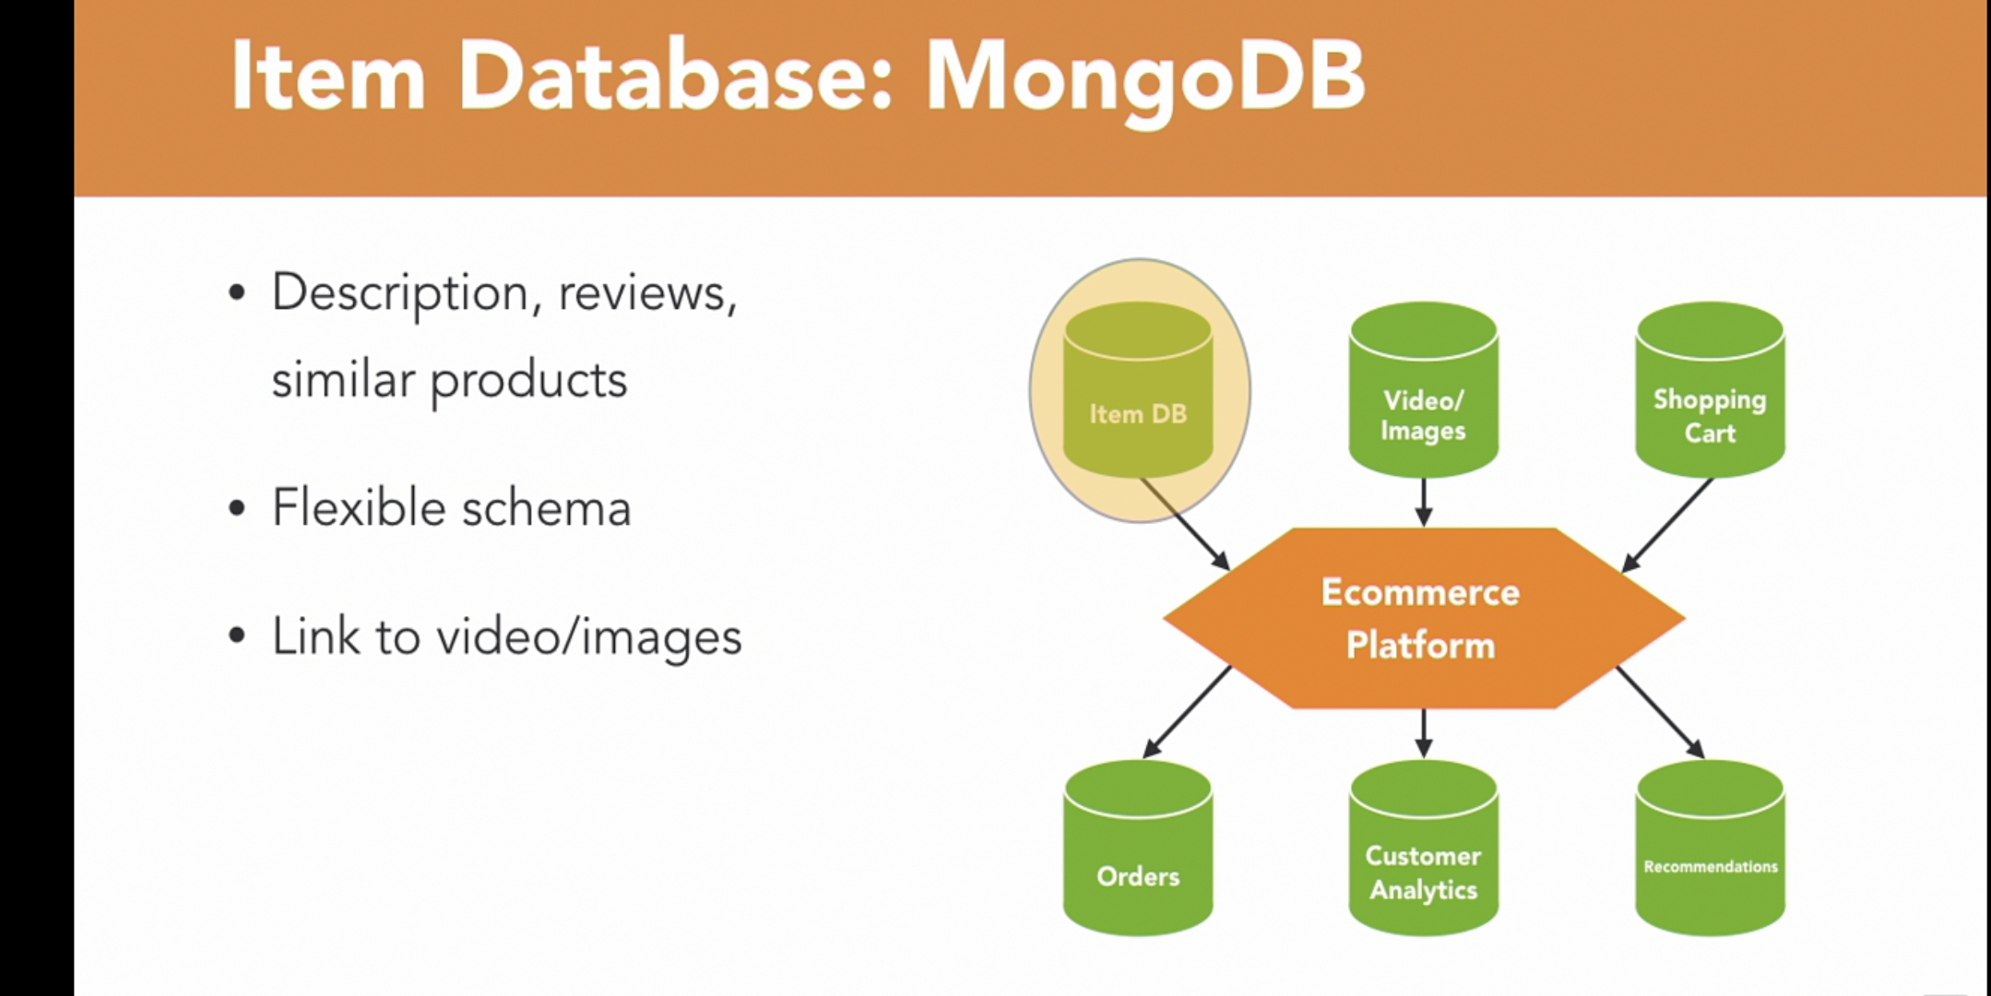
Choosing Database for Your Projects

Slide 50
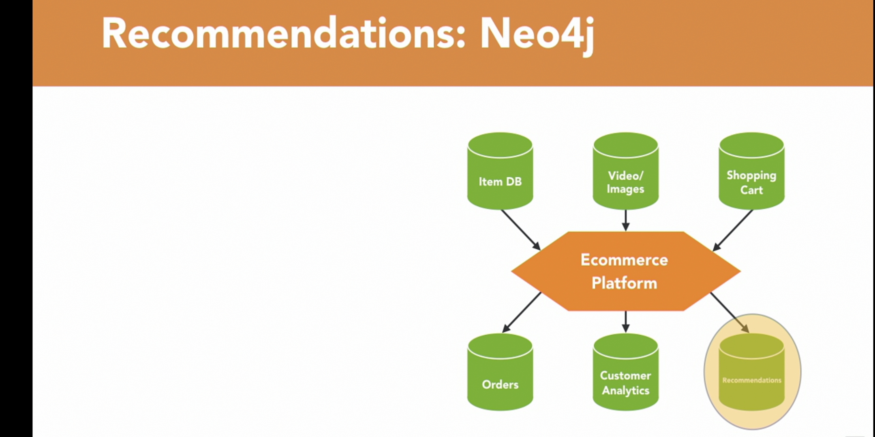
Choosing Database for Your Projects

Slide 51
2. Databases Fundamentals

Slide 52
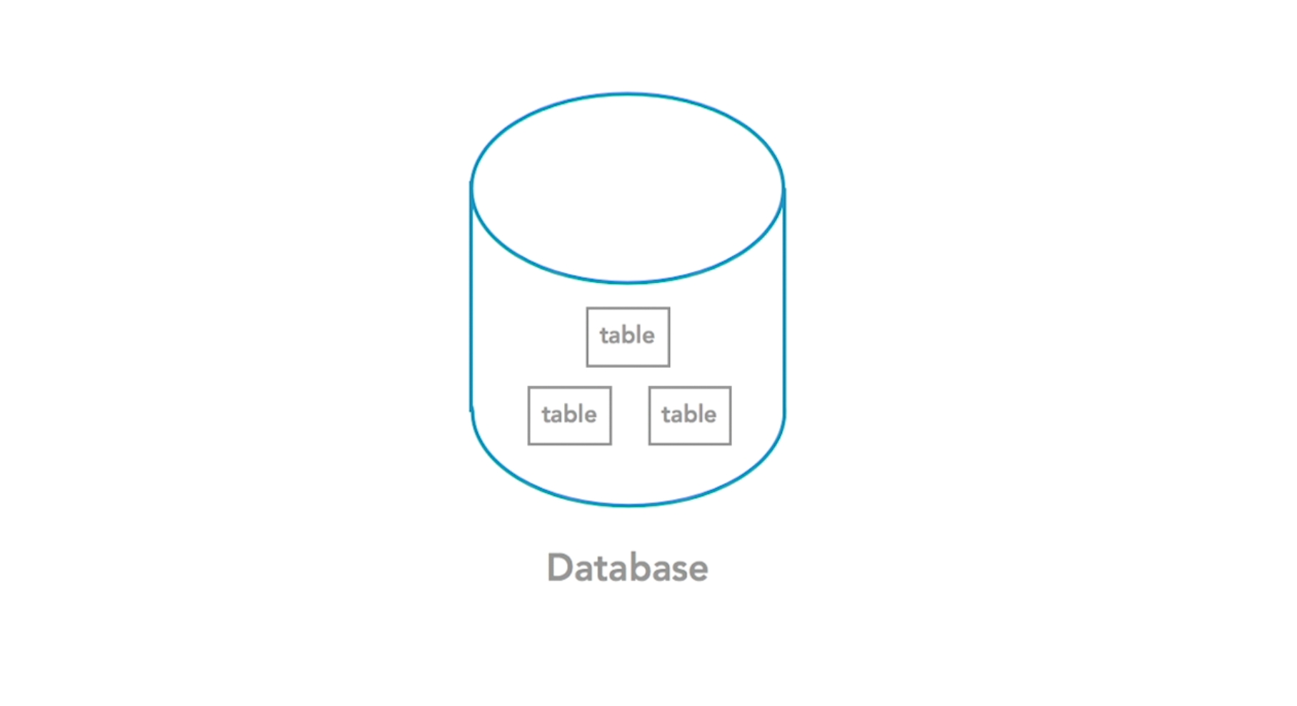
2.1 Feature of Relational Database

Slide 53
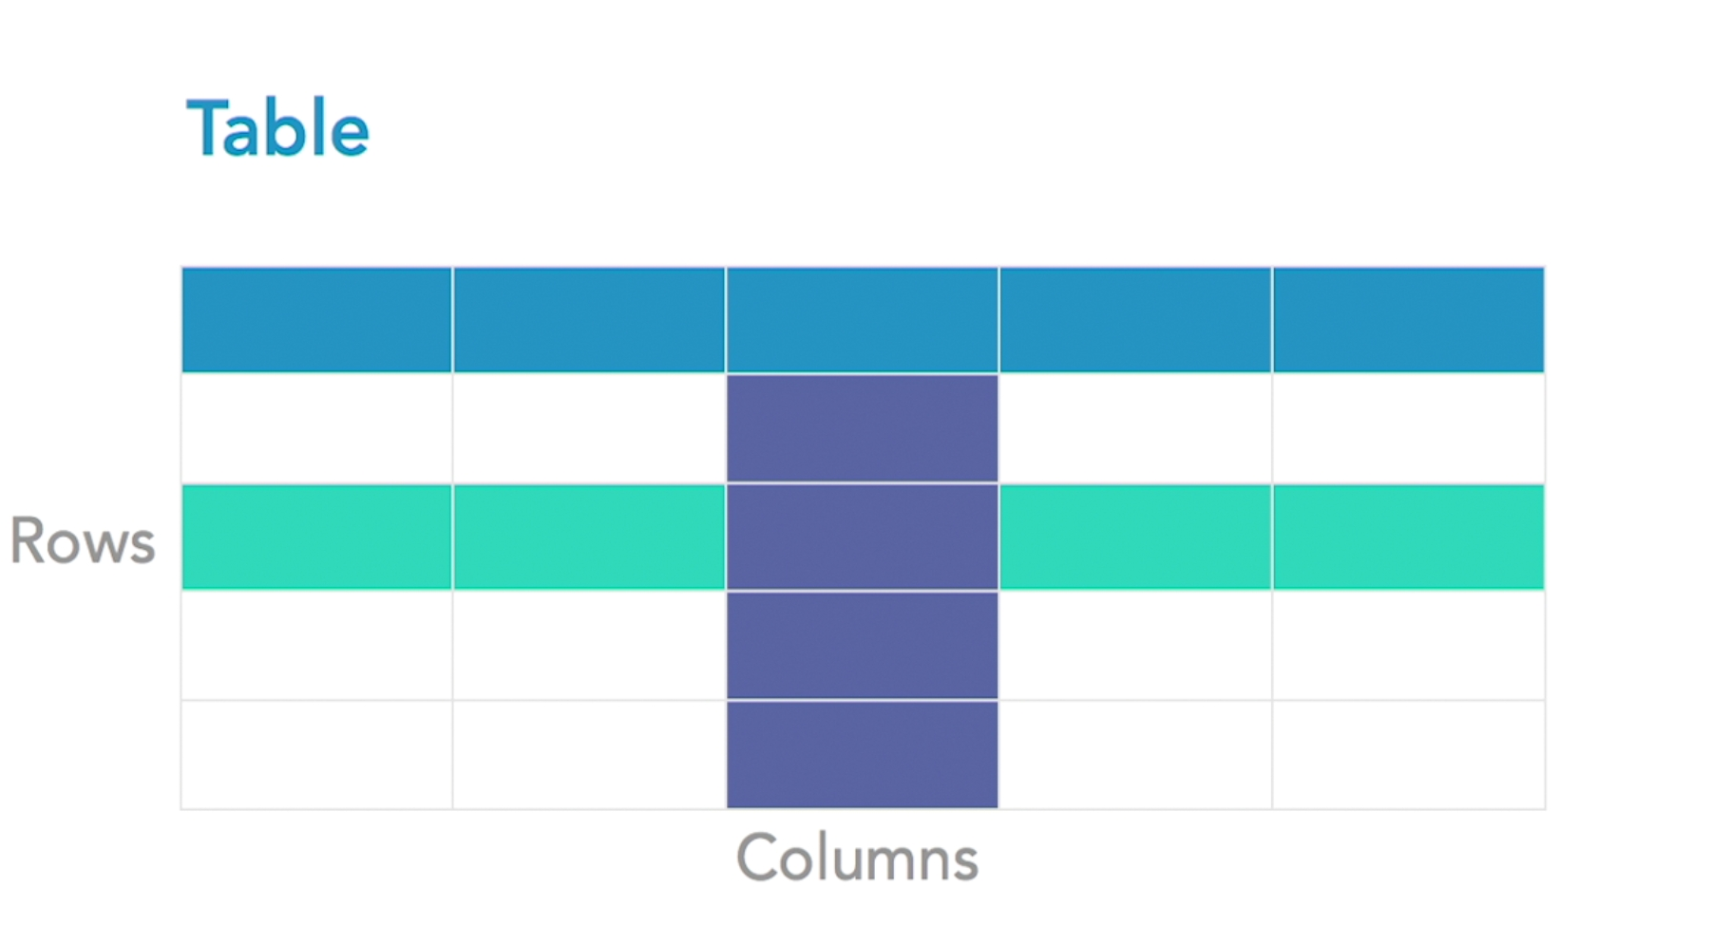
2.1 Feature of Relational Database

Slide 54
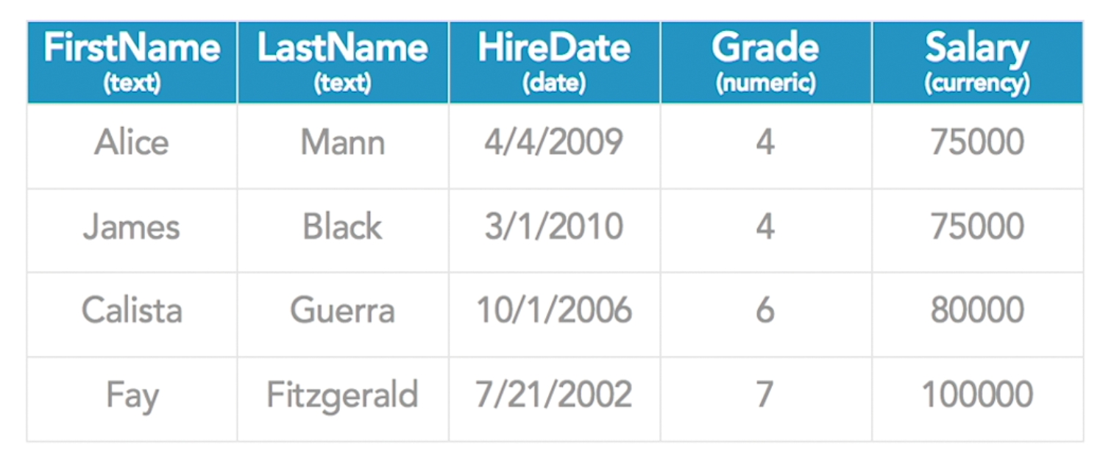
2.1 Feature of Relational Database

Slide 55

2.1 Feature of Relational Database

Slide 56

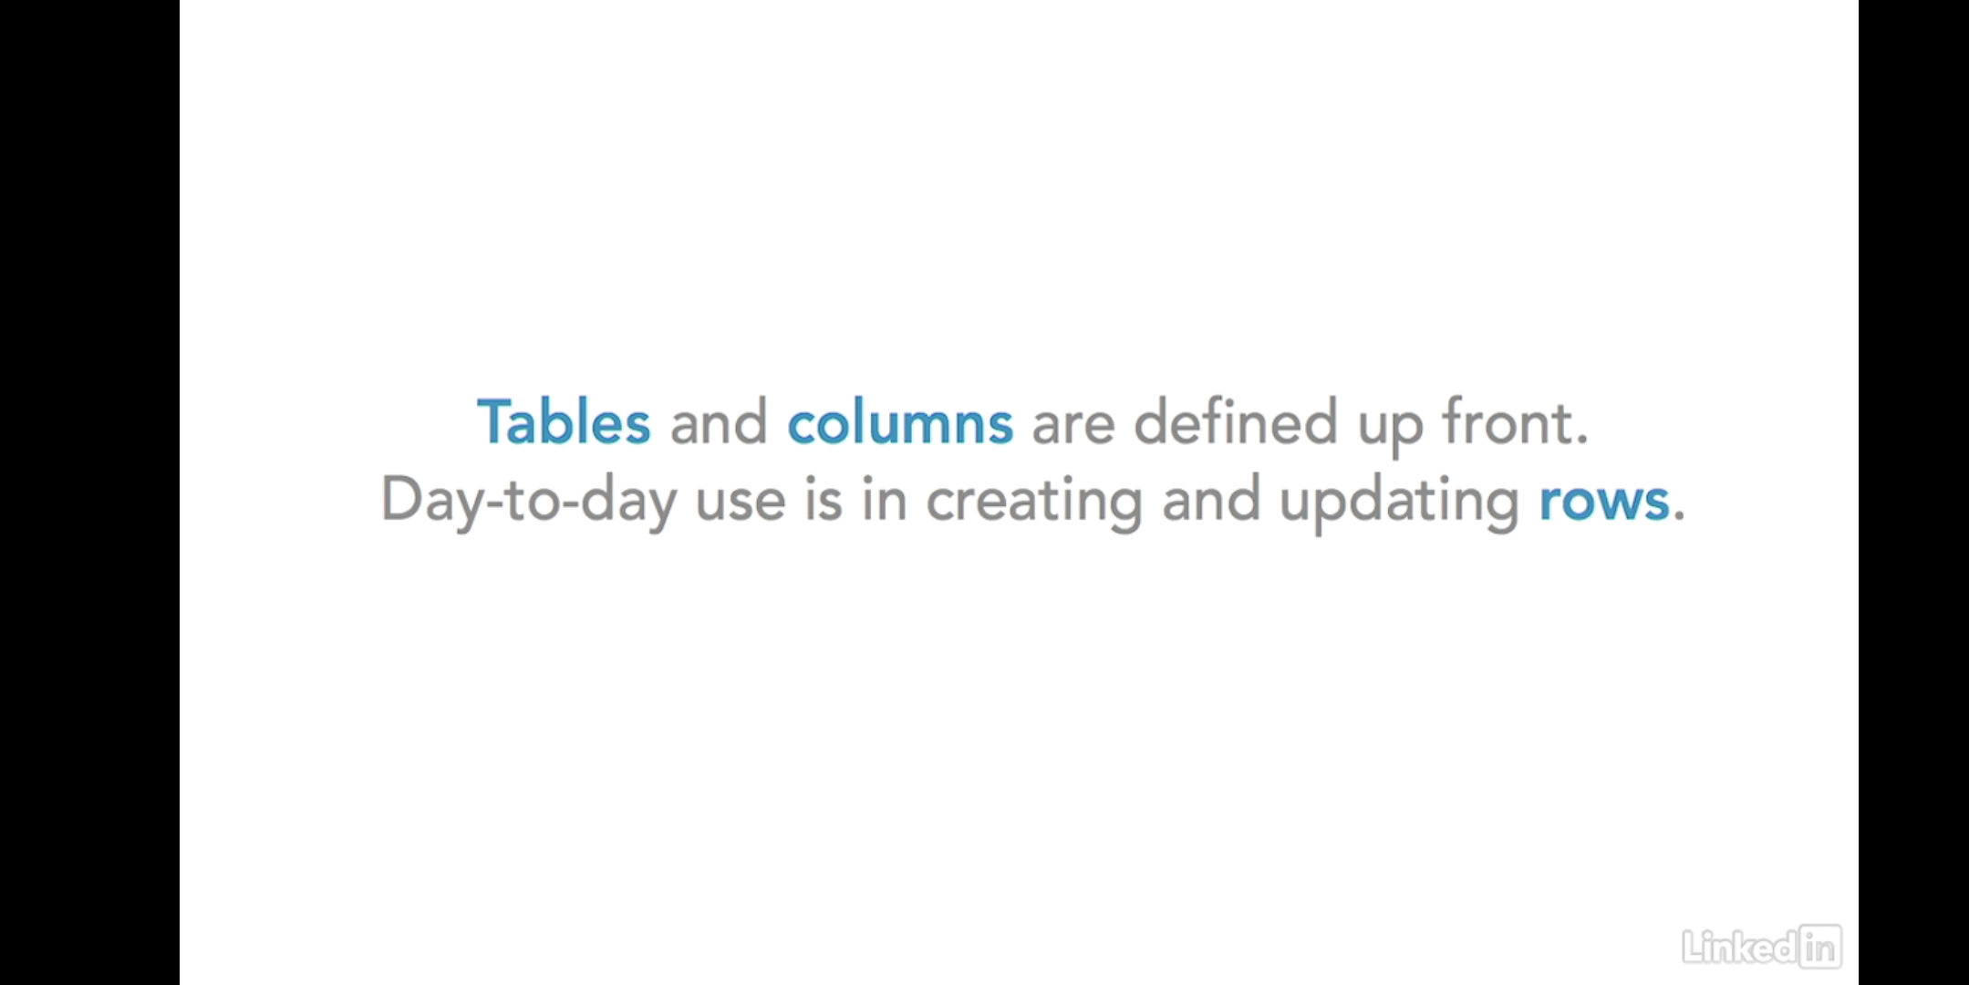
2.1 Feature of Relational Database

Slide 57
2.2 Exploring unique values and primary keys

Slide 58
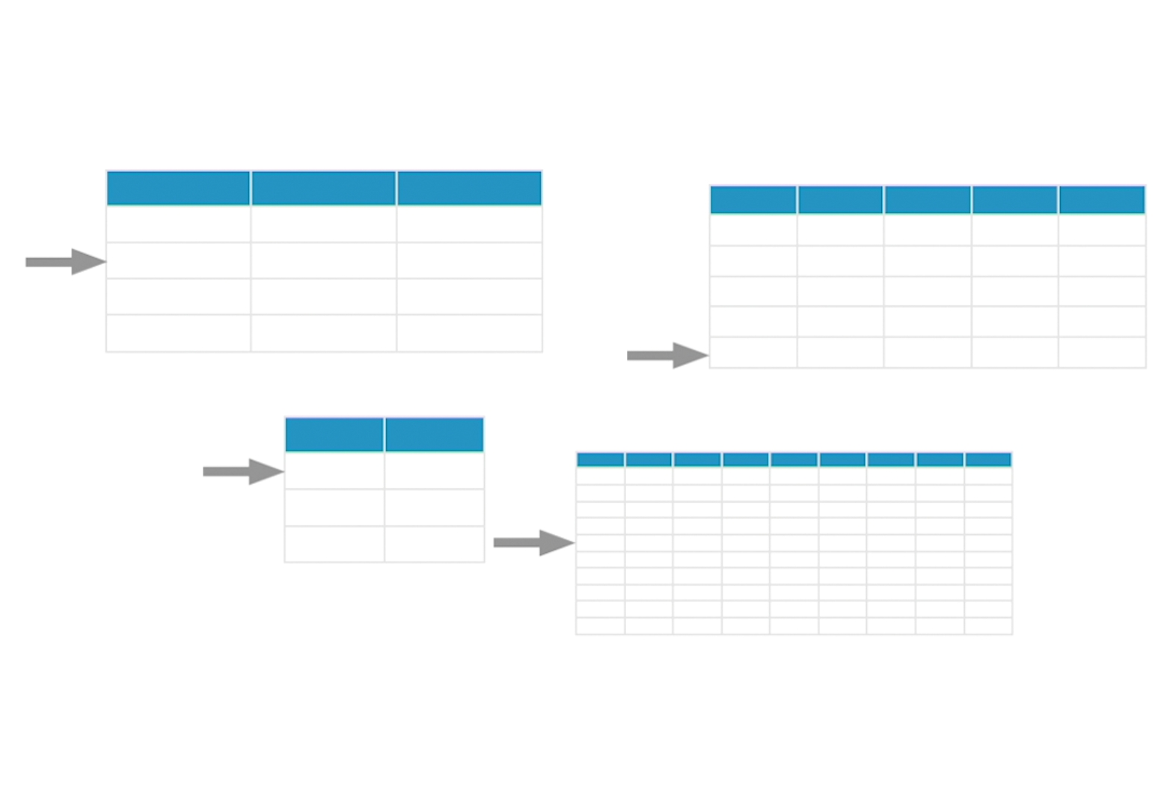
2.2 Exploring unique values and primary keys

Slide 59
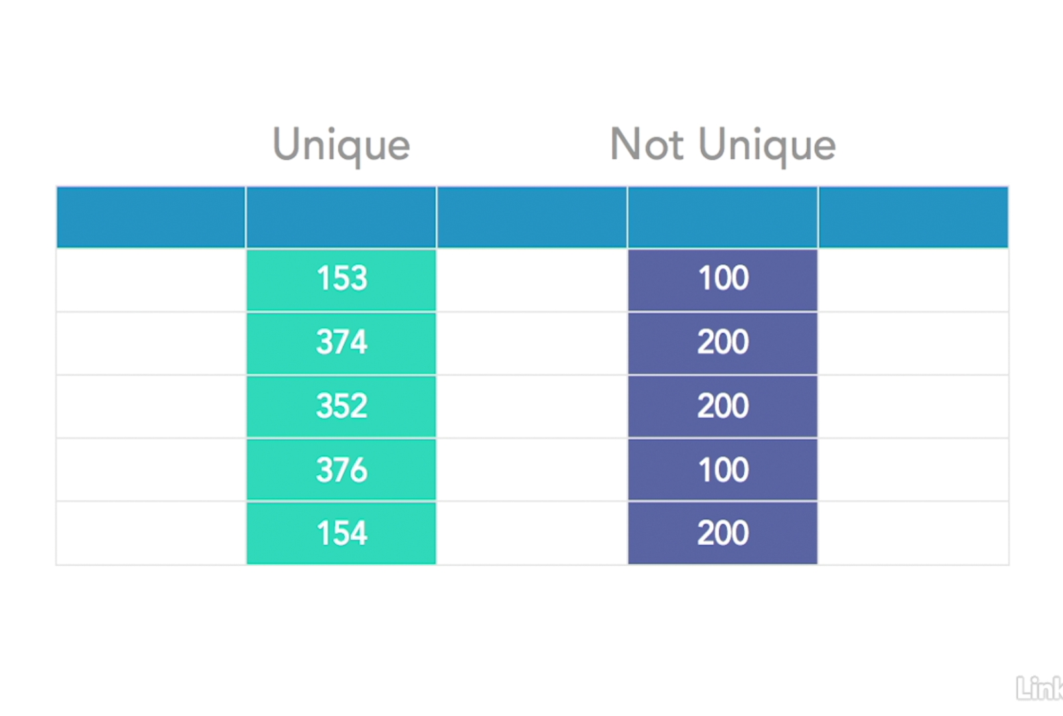
2.2 Exploring unique values and primary keys

Slide 60
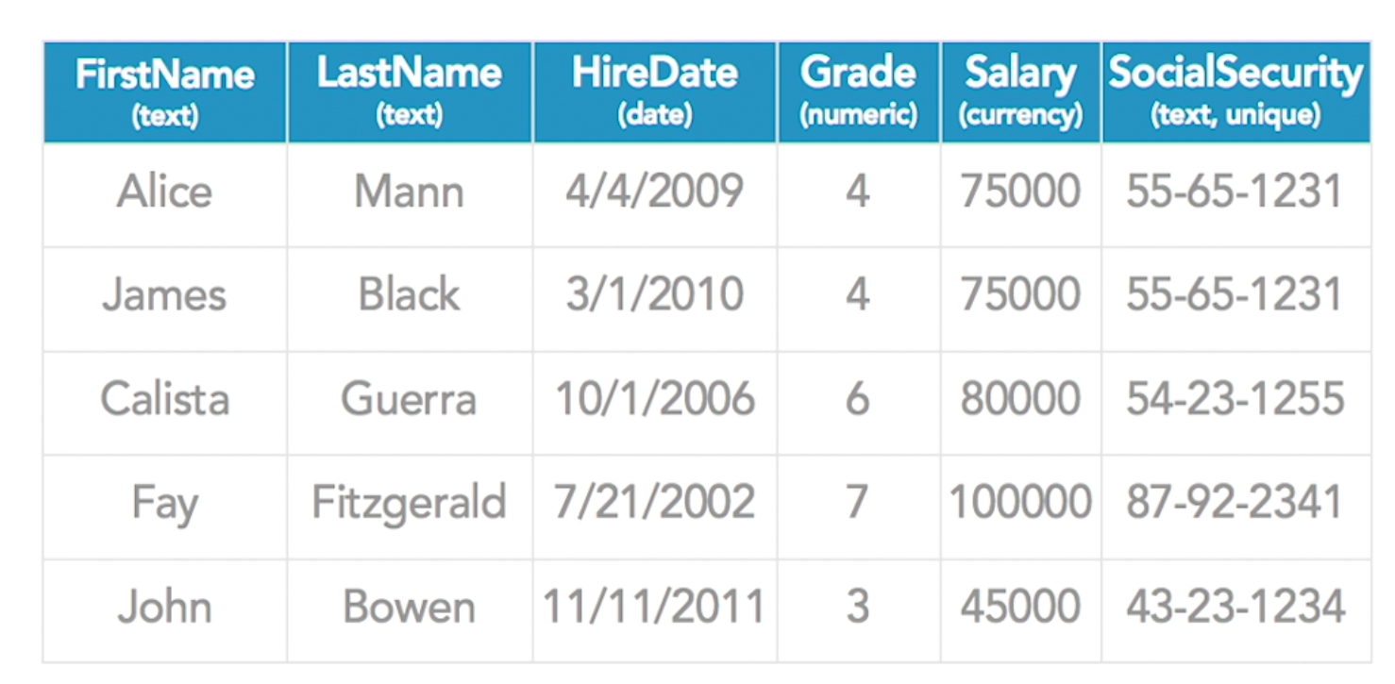
2.2 Exploring unique values and primary keys
??

Slide 61

2.2 Exploring unique values and primary keys

Slide 62

2.3 Defining table relationships

Slide 63

2.3 Defining table relationships

Slide 64

2.3 Defining table relationships

Slide 65

2.3 Defining table relationships

Slide 66

2.3 Defining table relationships

Slide 67

2.3 Defining table relationships

Slide 68

2.4 Describing many-to-many relationships

Slide 69

2.4 Describing many-to-many relationships

Slide 70

2.4 Describing many-to-many relationships

Slide 71

2.4 Describing many-to-many relationships

Slide 72

2.4 Describing many-to-many relationships

Slide 73

2.4 Describing many-to-many relationships

Slide 74

2.5 Transactions and the ACID test

Slide 75

2.5 Transactions and the ACID test

Slide 76

2.5 Transactions and the ACID test

Slide 77

2.5 Transactions and the ACID test

Slide 78

2.5 Transactions and the ACID test

Slide 79
3. Databases Modeling Tables

Slide 80


3.1 Intro to database modeling

Slide 81

3.1 Intro to database modeling

Slide 82

3.1 Intro to database modeling

Slide 83

3.1 Intro to database modeling

Slide 84

3.2 Identifying columns and selecting data types

Slide 85

3.2 Identifying columns and selecting data types

Slide 86

3.3 Choosing Primary Keys

Slide 87

3.4 Using Composite Keys

Slide 88

3.4 Using Composite Keys

Slide 89


3.4 Using Composite Keys

Slide 90
4. Databases Modeling Relationships

Slide 91

4.1 Creating relationships

Slide 92

4.1 Creating relationships

Slide 93

4.2 Defining one-to-many relationships

Slide 94

4.2 Defining one-to-many relationships

Slide 95

4.2 Defining one-to-many relationships

Slide 96

4.2 Defining one-to-many relationships

Slide 97

4.2 Defining one-to-many relationships
X

Slide 98

4.2 Defining one-to-many relationships

Slide 99

4.2 Defining one-to-many relationships

Slide 100

4.2 Defining one-to-many relationships

Slide 101


4.2 Defining one-to-many relationships

Slide 102

4.3 Exploring one-to-one relationships
One-to-One Relationship

Slide 103

4.3 Exploring one-to-one relationships
One-to-One Relationship

Slide 104

4.4 Exploring many-to-many relationships

Slide 105

4.4 Exploring many-to-many relationships

Slide 106

4.4 Exploring many-to-many relationships

Slide 107

4.4 Exploring many-to-many relationships

Slide 108

4.4 Exploring many-to-many relationships

Slide 109

4.4 Exploring many-to-many relationships

Slide 110

4.4 Exploring many-to-many relationships

Slide 111

4.5 Understanding relationship rules and referential integrity

Slide 112

4.5 Understanding relationship rules and referential integrity

Slide 113

4.5 Understanding relationship rules and referential integrity

Slide 114

4.5 Understanding relationship rules and referential integrity
Cannot be deleted if orders with this CustomerID are not deleted

Slide 115
5. Databases Modeling Optimization
Understand normalization
First normal form
Second normal form
Third normal form
Database denormalization

Slide 116

5.1 Understand normalization

Slide 117

5.1 Understand normalization

Slide 118
5.2 First normal form
1nf: if and only if the domain of each attribute contains only atomic (indivisible) values, and the value of each attribute contains only a single value from that domain.

Slide 119

5.2 First normal form
X

Slide 120

5.2 First normal form
X

Slide 121

5.2 First normal form
Good

Slide 122

5.3 Second normal form

Slide 123

5.3 Second normal form

Slide 124

5.3 Second normal form

Slide 125

5.3 Second normal form

Slide 126

5.3 Third normal form

Slide 127

5.3 Third normal form

Slide 128

5.3 Third normal form

Slide 129

5.3 Third normal form

Slide 130

5.3 Third normal form

Slide 131

5.3 Third normal form

Slide 132

5.3 Third normal form

Slide 133

5.3 Third normal form

Slide 134

5.4 Database denormalization

Slide 135

5.4 Database denormalization

Slide 136

6. Database Modeling Querying

Slide 137

Database Modeling Querying
https://sqlitebrowser.org/

Slide 138


Database Modeling Querying

Slide 139

Database Modeling Querying

Slide 140

Database Modeling Querying

Slide 141

Database Modeling Querying

Slide 142


Database Modeling Querying

Slide 143

Database Modeling Querying

Slide 144

Database Modeling Querying
Specify database if table name is duplicated for multiple databases

Slide 145


Structuring the WHERE Clause

Slide 146

Structuring the WHERE Clause

Slide 147

Structuring the WHERE Clause

Slide 148

Structuring the WHERE Clause

Slide 149

Structuring the WHERE Clause

Slide 150

Structuring the WHERE Clause

Slide 151

Structuring the WHERE Clause

Slide 152

Structuring the WHERE Clause
**However, using LIKE in SQL is very inefficient because it has to check multiple possible contents rather than just checking for pure equality

Slide 153

Structuring the WHERE Clause

Slide 154

Structuring the WHERE Clause

Slide 155

Sorting Results

Slide 156
Sorting Results

Slide 157

Sorting Results

Slide 158

Sorting Results

Slide 159

Sorting Results

Slide 160

Sorting Results

Slide 161

Using Aggregate Functions
What if we want to know how many rows?

Slide 162

Using Aggregate Functions

Slide 163

Using Aggregate Functions

Slide 164



Using Aggregate Functions

Slide 165

Using Aggregate Functions

Slide 166

Using Aggregate Functions

Slide 167

Using Aggregate Functions

Slide 168

Joining Tables

Slide 169

Joining Tables

Slide 170

Joining Tables

Slide 171

Joining Tables
Use “INNER JOIN” to be more specific: only bring back the rows where there is a match in both tables

Slide 172

Joining Tables

Slide 173

Joining Tables

Slide 174

Inserting, Updating, and Deleting

Slide 175

Inserting, Updating, and Deleting

Slide 176

Inserting, Updating, and Deleting

Slide 177

Inserting, Updating, and Deleting

Slide 178

Inserting, Updating, and Deleting

Slide 179

Inserting, Updating, and Deleting

Slide 180

Inserting, Updating, and Deleting

Slide 181


Inserting, Updating, and Deleting
Good practice: be careful when you delete, try select first and then change command to delete

Slide 182

The Data Definition Language

Slide 183



The Data Definition Language
ALTER TABLE Persons
ADD Email varchar(100);
DROP TABLE Persons;
CREATE TABLE Persons
(
PersonID int,
LastName varchar(255),
FirstName varchar(255),
Address varchar(255),
City varchar(255)
);
More SQL examples at https://www.w3schools.com/sql/default.asp

Slide 184

SQL Statement Types
More SQL examples at https://www.w3schools.com/sql/default.asp

Slide 185
Database Modeling Querying
Let’s try our FoodTasker App

Slide 186

Database Modeling Querying
Let’s try out https://www.w3schools.com/sql/

Slide 187

Database Modeling Querying
Let’s try out https://www.tutorialspoint.com/sql/

Slide 188
7. Database Modeling: Indexing and Optimization

Slide 189


Indexing (Speed of accessing data)

Slide 190

Indexing (Speed of accessing data)
This query is gonna be very fast!!
Each table can have only 1 clustered index

Slide 191

Indexing (Speed of accessing data)
Good or Bad??

Slide 192
Indexing (Speed of accessing data)
Query like this will require a DBMS to start at the first row and read through one by one
Full table Scan

Slide 193

Indexing (Speed of accessing data)
Solution : Create Non-Clustered Index

Slide 194

Indexing (Speed of accessing data)
Not a good idea to make all column as Non-Clustered Index

Slide 195

Indexing (Speed of accessing data)

Slide 196

Write conflicts
***

Slide 197

Write conflicts
This is fine

Slide 198

Write conflicts
What if Alice and Bob logon at the same time and try to execute transactions

Slide 199

Write conflicts
Solution: Step1 make this atomic by making them transaction

Slide 200

Write conflicts
Solution: Step2 Pessimistic Locking

Slide 201

Write conflicts
This still not so good for Bob even though it takes millisec

Slide 202

Write conflicts
Solution: Step2 Optimistic Locking

Slide 203

Stored Procedures and Injection Attacks
Create Procedure to reuse the query

Slide 204

Stored Procedures and Injection Attacks

Slide 205

Stored Procedures and Injection Attacks

Slide 206

Stored Procedures and Injection Attacks

Slide 207

Stored Procedures and Injection Attacks

Slide 208

Stored Procedures and Injection Attacks

Slide 209

Stored Procedures and Injection Attacks
Most database use Stored Procedure rather than constructing your own strings to prevent SQL injection

Slide 210
8. Database Options

Slide 211

Relational Database Management System

Slide 212

XML and Object-Oriented Database System

Slide 213

Object-Relational Mapping (ORM)

Slide 214

NoSQL Database System - Not only SQL

Slide 215

NoSQL Database System - Not only SQL

Slide 216

NoSQL Database System - Not only SQL

Slide 217

Document Stores

Slide 218

Key-Value Stores
Very fault-tolerant distributed architecture

Slide 219

Graph Database

Slide 220

Reason to Choose a NoSQL Database

Slide 221
Go to next chapter: Week2 NoSQL
https://docs.google.com/presentation/d/1lHW5QC6n6W1PH-W_ruqzQW_A9v0pctJIzXyGQw-1DRg/edit?usp=sharing

